Slide 1
Talking Like a Plant Scientist
Vocabulary Slidedeck
Exemplar and Vocabulary Cards

Slide 2
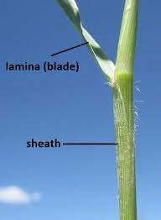
Exemplar
Sheath
Page: 22
Meaning from Context: Stem or main branch of a plant
Reference Definition: A structure in living tissue which closely envelops another
Use in Sentence: The sheath of the plant had a different texture and color than the rest of the foliage
Image or Illustration: to the right

Slide 3
Instructions
All students are assigned one word/slide where you must try to guess the meaning of the vocabulary word through context found on the page indicated. Then, once you think you know the meaning, look up the definition on line using a reputable reference source (Apple’s dictionary app, Merriam Webster, Wikipedia, etc.). Each slide should include:
Word & Page number
Definition from Context
Reference Definition
Use in a Sentence
Illustration

Slide 4
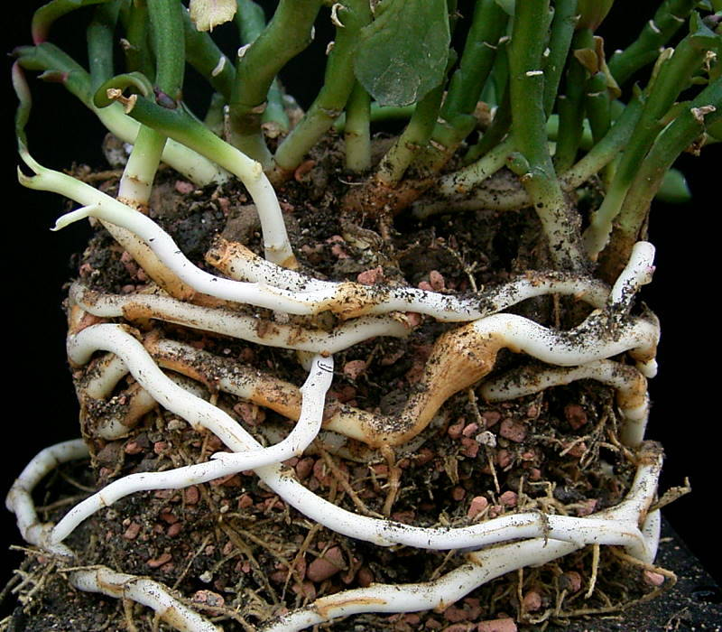
Rhizomes
Page: 44
Meaning from Context: Seeds that a plant sends out underground to grow new plants
Reference Definition: “the thick stem of some plants, such as iris and mint, that grows along or under the ground and has roots and stems growing from it”
https://www.oxfordlearnersdictionaries.com/us/definition/english/rhizome
Use in a Sentence: The plant was already growing rhizomes after only a few hours.
https://en.wikipedia.org/wiki/Rhizome

Slide 5
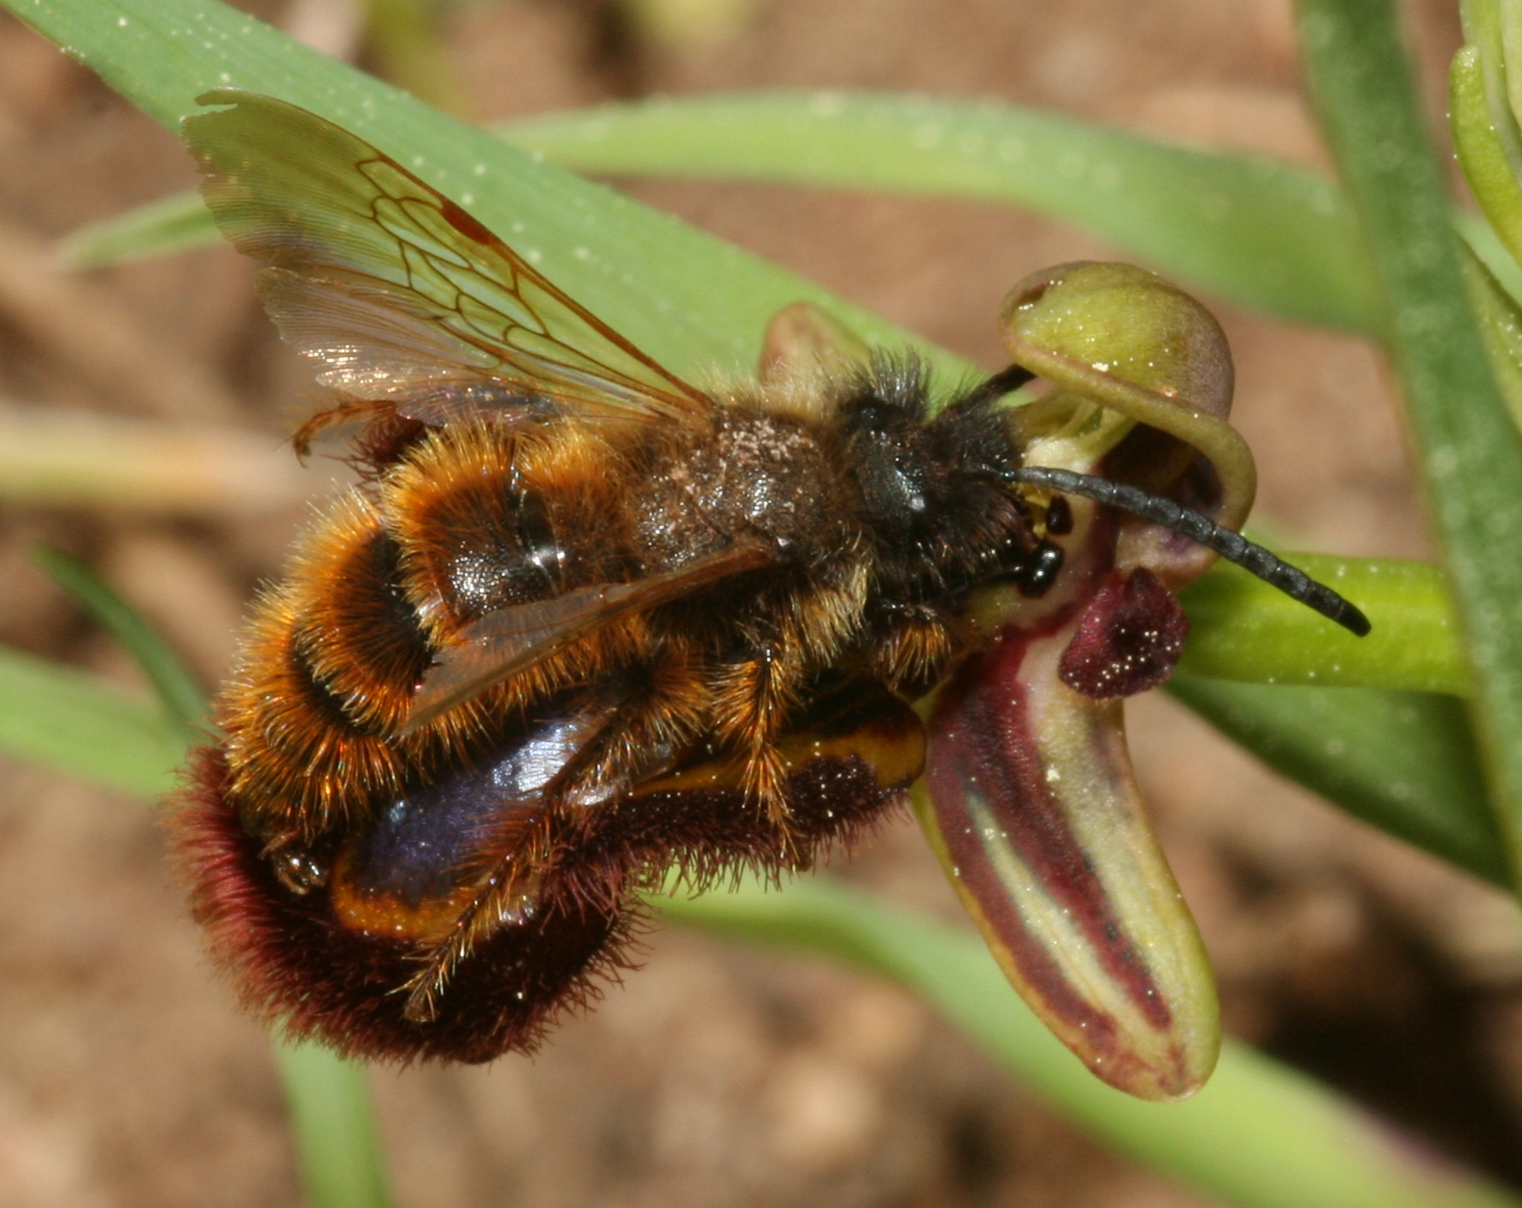
2. Allomones
Page: 46
Meaning from Context: It’s a “chemicals weapons”. It releases chemicals from its roots to keep anything else from growing in the soil.
Reference Definition: a chemical substance secreted externally by certain animals, such as insects, affecting the behaviour of another species.
Use in a Sentence: The larvae feed on termites which they subdue with an aggressive allomone.
Image or Illustration:
Notes:
Gabrielle Griffiths

Slide 6
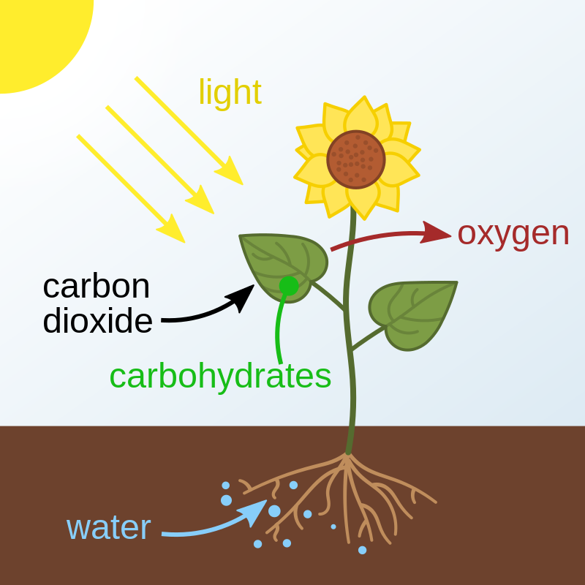
3. Photosynthesis
Page: 48
Meaning from Context: the process where plants get their color from
Reference Definition: “the process by which green plants and some other organisms use sunlight to synthesize foods from carbon dioxide and water. Photosynthesis in plants generally involves the green pigment chlorophyll and generates oxygen as a byproduct.” - oxford languages
Use in a Sentence: The photosynthesis helps plants to grow
Image or Illustration:

Slide 7
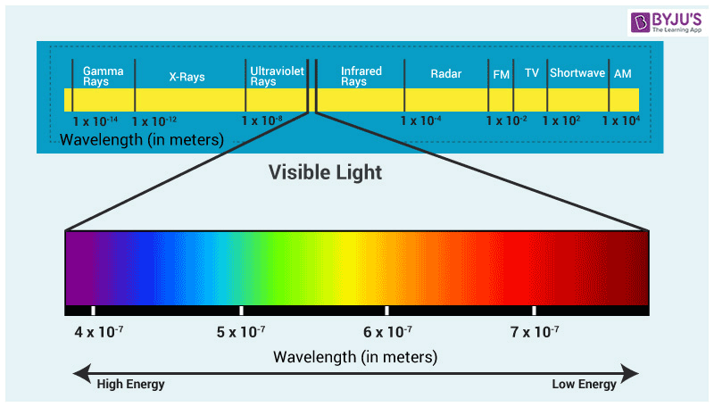
4. Wavelength
Page: 48
Meaning from Context: Plants that can absorb any type of light
Reference Definition: “The distance in the line of advance of a wave from any one point to the next point of corresponding phase”
Use in a Sentence: The wavelength of the sun made my skin burn over time
Image or Illustration:
Notes:
https://byjus.com/physics/wavelength-of-light/ -picture
https://www.merriam-webster.com/dictionary/wavelength - definition

Slide 8
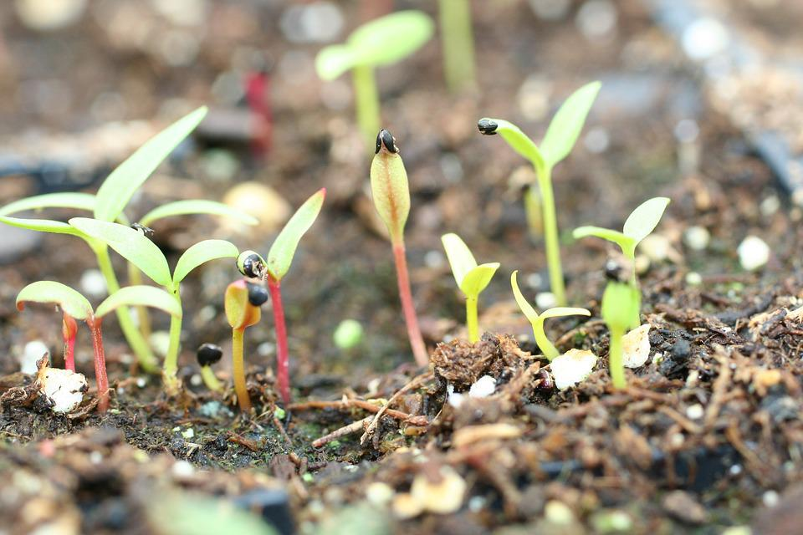
5. Germinate
Page: 52
Meaning from Context: cultivates/grows from its nutrients
Reference Definition: To begin to grow and develop (dictionary.com)
Use in a Sentence: As I planted the seeds for my pumpkin, in a few months I got to see it germinate over time.
Image or Illustration: top right

Slide 9
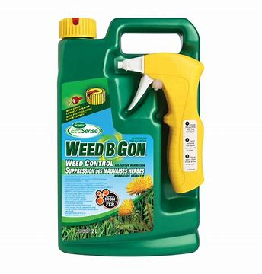
6. Herbicide (Nilayza De La Rosa)
Page: 53
Meaning from Context: A substance that kills off/inconveniences any unwanted plant species.
Reference Definition: An agent used to destroy or inhibit plant growth (Merriam Webster).
Use in a Sentence: My grandfather uses an herbicide when he wants to kill off weeds in our yard.
Links:
Definition: Herbicide Definition & Meaning - Merriam-Webster
Image: https://th.bing.com/th/id/OIP.vt2DiZktO3R5AJFOiqLT1gHaHa?w=172&h=180&c=7&r=0&o=5&dpr=2&pid=1.7

Slide 10
7. Undifferentiated
Page: 72
Meaning from Context: Yet to become different from another part of the plant.
Reference Definition: Not divided or able to be divided into different elements, types, etc. : not differentiated https://www.merriam-webster.com/dictionary/undifferentiated
Use in a Sentence: The stem of the plant had not yet differentiated into several stalks.
Image or Illustration: https://shopsale.storesonline2022.ru/category?name=cell%20differentiation%20in%20plants

Slide 11
8. Tendril
Page: 152, 251
Meaning from Context:small tubular appendage
Reference Definition: threadlike, leafless organ of climbing plants, often growing in spiral form, which attaches itself to or twines round some other body, so as to support the plant. https://www.dictionary.com/browse/tendril
Use in a Sentence: Lengthy tendrils of kudzu smothered the building to a point where it was difficult to see in or out of the windows.
Image or Illustration: top right https://www.istockphoto.com/vector/twisted-wild-lianas-branches-set-gm1080231862-289543370

Slide 12
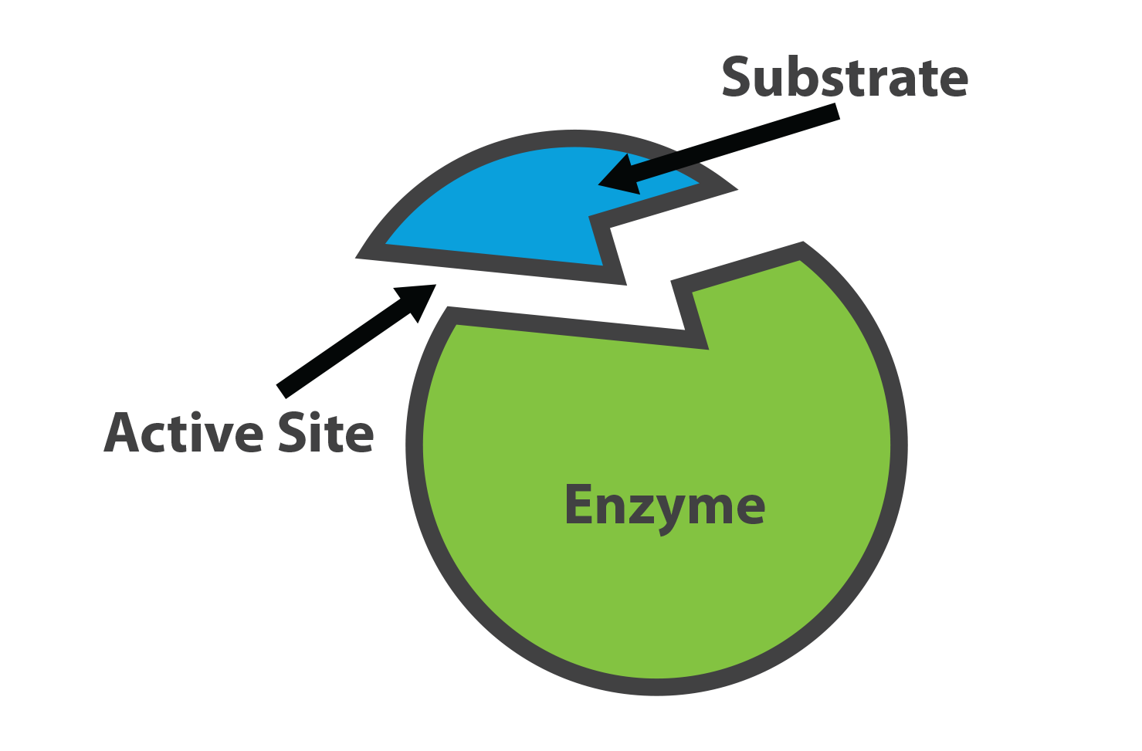
9. Enzyme
Page: 156
Meaning from Context: Corrosive chemical that has a negative impact on what comes into contact with it.
Reference Definition: Biological chemical and protein that produces a specific reaction. Typically speeds up a chemical reaction.
Use in a Sentence: Enzymes help the breakdown of food in the digestive system.
Image or Illustration: https://www.substrata.us/blog/what-is-an-enzyme

Slide 13
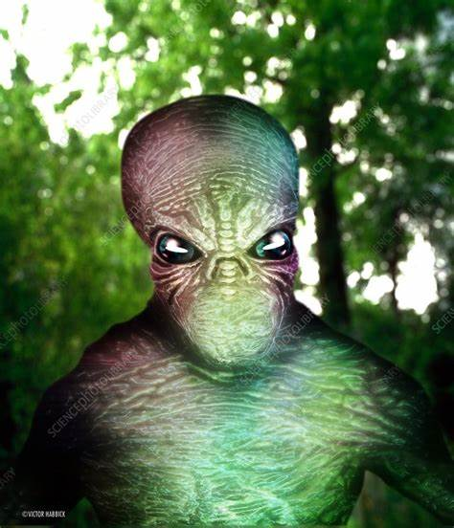
10. Alien
Page: 157
Meaning from Context: Not native; from another plant
Reference Definition: Someone who was not born in the “place” they are currently residing in.
Use in a Sentence: Illegal aliens enter the U.S. everyday.
(1) alien - Bing images

Slide 14
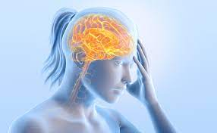
11. Cryptogenic
Page: 158
Meaning from Context: unknown origin
Reference Definition: of obscure or unknown origin
Use in a Sentence: She had a cryptogenic seizure.
Image or Illustration: https://www.merriam-webster.com/dictionary/cryptogenic

Slide 15
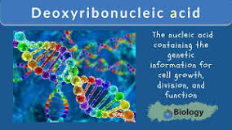
12. DNA
Page: 158
Meaning from Context: Running lab tests to determine something
Reference Definition: Genetic information of an organism
Use in a Sentence: We ran DNA tests on the animals.
Image or Illustration:
https://www.cancer.gov/publications/dictionaries/genetics-dictionary/def/dna

Slide 16
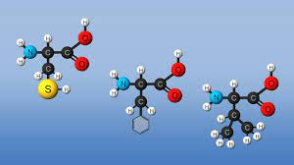
13. Amino acids
Page: 158
Meaning from Context: The Building block (Proteins) for plant life.
Reference Definition: Amino acids are molecules that combine to form proteins. https://medlineplus.gov/ency/article/002222.htm
Use in a Sentence: Plants use amino acids which are a vital role in nutrition.
Image or Illustration: https://www.britannica.com/science/amino-acid

Slide 17
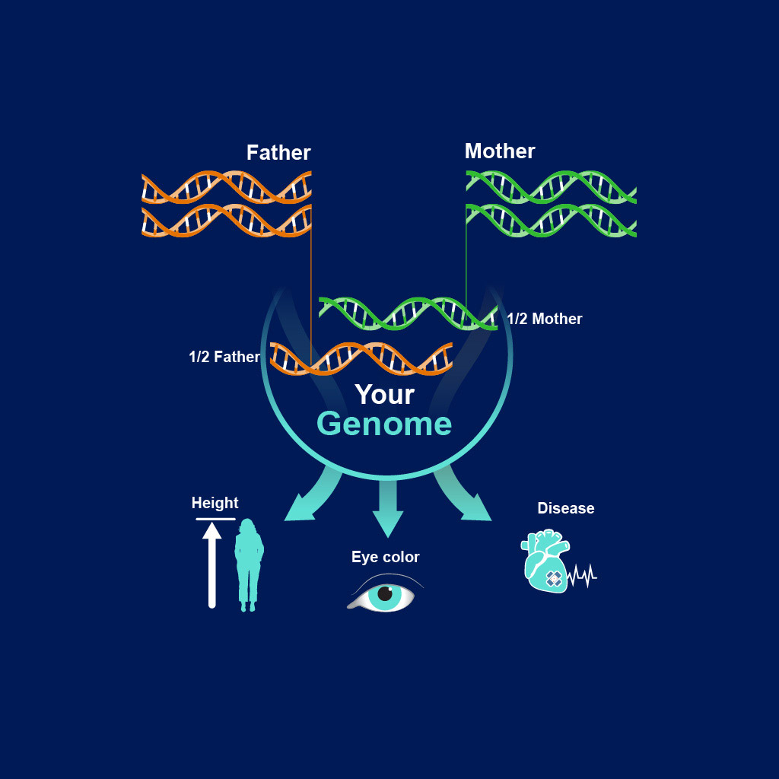
14. Genome
Page: 169
Meaning from Context: A map of your genes, AKA your DNA
Reference Definition: The entire set of DNA instructions found in a cell
Use in a Sentence: Two people may have very similar
characteristics, but their genome will be different
Image or Illustration:
https://www.genome.gov/About-Genomics/Introduction-to-Genomics (For image and def.)

Slide 18
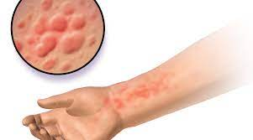
15. Aquagenic Urticaria
Page: 25
Meaning from Context: A condition where you are allergic to water.
Reference Definition: A rare condition in which hives develop rapidly after skin comes in contact with water. https://rarediseases.info.nih.gov/diseases/10901/aquagenic-urticaria
Use in a Sentence: “Maybe her skin would become a permanent red, itchy mess, and maybe one day she wouldn’t even be able to drink water!”
Image or Illustration:https://allergykb.org/content/aquagenic-urticaria/

Slide 19
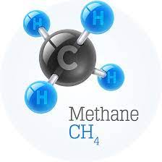
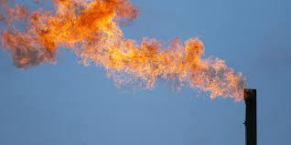
16. Methane
Page: 259
Meaning from Context: A chemical acid
Reference Definition: A colorless and odorless flammable gas, that is from decomposition of organic matter and of carbonization of coal.
Merriam Webster - Methane
Use in a Sentence: The truck runs on methane gas that is natural gas that may be created in several ways.
Image or Illustration: Bottom Right
Edf.org
Worldatlas.com

Slide 20
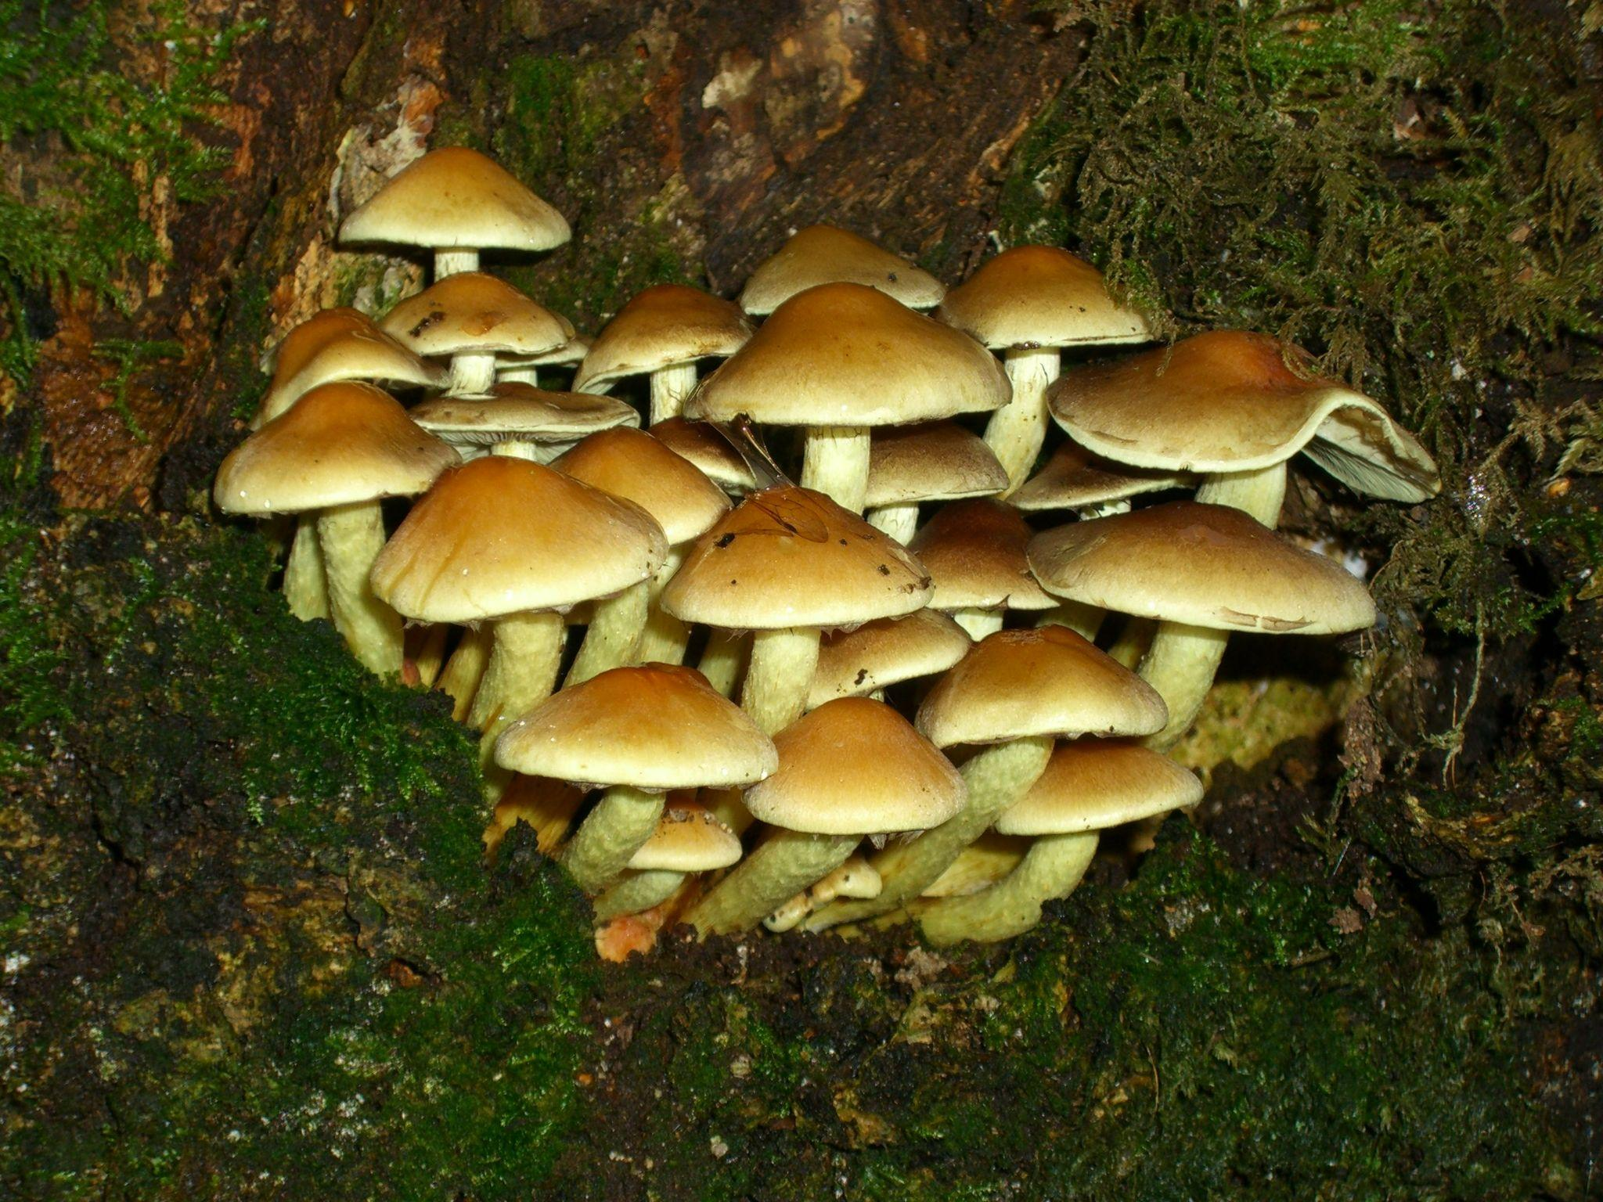
17. Fungal Ecosystem
Page: 264
Meaning from Context: A gathering of mushrooms or type of fungi in a ecosystem like a forest or ocean
Reference Definition: The complex of a community of organisms and its environment functioning as an ecological unit
Use in a Sentence: “You sometimes get these rare fungal ecosystems in isolated places. Like the South American rainforest. Totally unique bacteria.”
Image or Illustration: (505) Pinterest Pintrest Clair McCoy
Definition Source: Ecosystem Definition & Meaning - Merriam-Webster

Slide 21
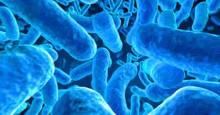
18. Bacterium
Page: 264
Meaning from Context: They see it as a virus killing the tendrils they planted
Reference Definition: a member of a large group of unicellular microorganisms which have cell walls but lack organelles and an organized nucleus, including some that can cause disease.
Use in a Sentence: Our bodies are covered in bacterium.
Image or Illustration:

Slide 22
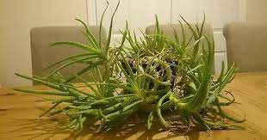
19. Unruly
Page: 10
Meaning from Context: crazy, wild or extraordinary
Reference Definition: disorderly and disruptive and not amenable to discipline or control
Use in a Sentence: An unruly plant isn’t really seen as much in a city than a forest or the wilderness.
Image or Illustration:

Slide 23
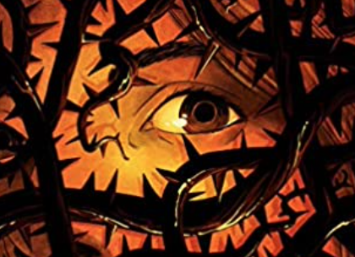
20. Invasive Species
I stole this image from Amazon
Page: 45
Meaning from Context: A plant that is a scoundrel, maybe bad??
Reference Definition: An invasive species is an introduced organism that becomes overpopulated and harms its new environment.^{[2]} Although most introduced species are neutral or beneficial with respect to other species,^{[3]} invasive species adversely affect habitats and bioregions, causing ecological, environmental, and/or economic damage (Wikipedia)
Use in a Sentence: As I walked around campus, I could see just how many of the plants used in the landscaping were invasive species.
Image or Illustration: SEE ABOVE RIGHT.

