Slide 1
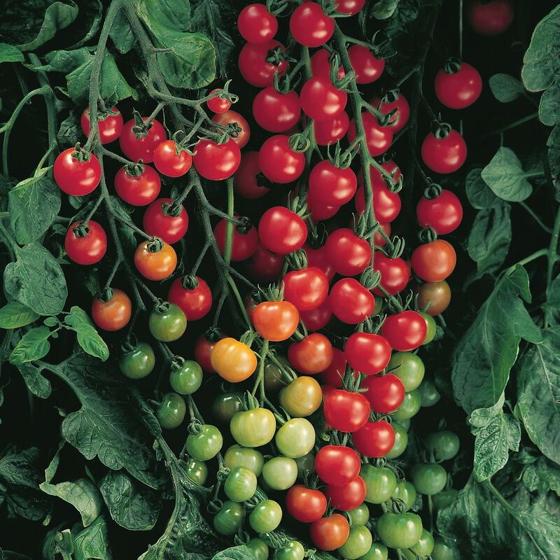
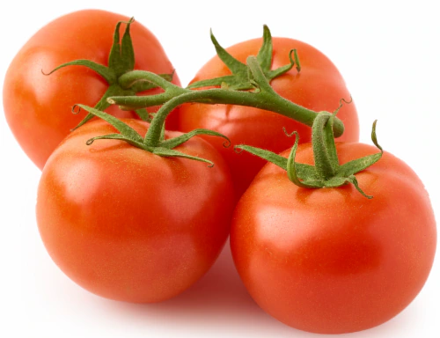
Agriculture in Action
Here Today, Gone Tomato
A game where you try to grow and sell tomatoes to make as much of a profit as you can by the end of the growing season.
Dr. Erin Friedman
Dr. Mindy Findlater

Slide 2
Here Today, Gone Tomato
Read through the provided list of gene/plant modifications that are available for tomatoes.
Now you get to create your own “super tomato”! Choose 4 of the modifications that you would like to “buy” at the start of your growing season.*
You will start with 100 tomatoes. We will walk you through various scenarios that occur through the growing season. Keep track of how many tomatoes you gain or lose! Each tomato type counts the same (as 1 tomato).
*This is for fun! You can’t actually pick and choose to stack modifications like this in the real world.

Slide 3
Here Today, Gone Tomato Growing Scenarios
Growing 1
Growing 2
Growing 3
Growing 4
Growing 5
Growing 6
Growing 7
Growing 8
Growing 9
Growing 10
Growing 11
Growing 12

Slide 4
Here Today, Gone Tomato
Now we transition from growing to selling!
Each tomato that you have left is now worth $2
Now track the amount of money that you have as we take you through a selling season!

Slide 5
Here Today, Gone Tomato Selling Scenarios
Selling 1
Selling 2
Selling 3
Selling 4
Selling 5
Selling 6
Selling 7
Selling 8
Selling 9
Selling 10
Selling 11
Selling 12

Slide 6
Here Today, Gone Tomato
Our season is over - who is our winner???

Slide 7
Here Today, Gone Tomato: Money Manager Edition
This time, we will play multiple rounds, and you can incorporate some strategy!
Round 1: Start with 100 tomatoes and $100. Spend your money wisely!
Choose what you want to buy
Put any leftover money in the “bank”
Price list:
$25 for additional 50 tomatoes (limit 2)
Modification prices (see table)
$20 each | 9, 11, 12, 15, 17
$30 each | 2, 5, 8, 10, 16,
$40 each | 1, 3, 4, 6, 14,
$50 each | 7, 13, 18

Slide 8
Here Today, Gone Tomato: Money Manager Edition
Each new round:
Receive 100 tomatoes and $50
All modifications are re-set
You can re-purchase your last round modifications for half price
You can purchase new modifications for full price
Put any leftover money in the “bank.”
Money in the bank does not count toward sales!
Price list:
$25 for additional 50 tomatoes (can buy as many as you want)
Modification prices (see table):
$20 each | 9, 11, 12, 15, 17
$30 each | 2, 5, 8, 10, 16,
$40 each | 1, 3, 4, 6, 14,
$50 each | 7, 13, 18
Notes:
Each round of selling scenarios only affects the current crop. The bank is only good for buying new mods between rounds and determining the winner at the end.

Slide 9
Growing Scenario 1
Oh no! There has been a swarm of White Flies in your area, resulting in your entire crop field being infected with Tomato Yellow Curl Virus! Lose 10 tomatoes unless your tomatoes are resistant to TYCV.
Back to Growing Season

Slide 10
Growing Scenario 2
You feel your tomatoes have attracted visitors! But, as you look over your field on this quiet morning you notice something peculiar. There are no consumers? But a black speck on the edge of a tomato plant catches your eye. Underneath the leaves you find your plant swarming with bugs…Oh thrip.. Over time, your tomato plants wilt and the stems are destroyed at a cellular level. The fruits show necrotic spots. Many of your yield dies; they have been infected by Tomato Spotted Wilt Virus! Lose 20 tomatoes unless your tomatoes are resistant to TSWV.
Back to Growing Season

Slide 11
Growing Scenario 3
After a relatively normal spring season, you move your tomatoes out of the greenhouse into the fields, only to experience an unseasonably cold week during the spring. The tomatoes struggle to thrive under this stress. All farmers reduce your tomato number by half (round up if you end up with half of a tomato)
Back to Growing Season

Slide 12
Growing Scenario 4
Global climate change affected your areas, and winter this year never bothered to show up. This means that the nighttime temperatures in your growing region are much hotter than usual when you are getting ready to harvest. Gain 10 tomatoes if you have heat-tolerant tomatoes.
Back to Growing Season

Slide 13
Growing Scenario 5
Effects of water availability: randomly choose option A or option B to see what happens!
Water Option A
Water Option B

Slide 14
Growing Scenario 5 A
Climate change rears its ugly head again in the form of a drought. Very little rain falls during the growing season, and your farms are not equipped with irrigation systems that can make up the difference. Lose 10 tomatoes unless you are growing drought-resistant tomatoes.
Back to Growing Season

Slide 15
Growing Scenario 5 B
New bills pass not allowing the movement of water throughout the valley where you farm. Because you are unable to acquire as much water this year as in previous years, your yield decreases by 15 tomatoes, unless you have drought tolerant tomatoes.
Back to Growing Season

Slide 16
Growing Scenario 6
The local Smokey Bear signs warn of high wildfire danger, but a group of careless campers fail to heed the warnings and leave their campfire unattended. Before it can be contained, the resulting fire spreads to all of the surrounding fields, completely destroying the crops. Game over: try again next year!
Back to Growing Season

Slide 17
Growing Scenario 7
Innovation! A new variety of mechanical tomato harvester is unveiled, and the competition drives prices for this harvesting machinery down considerably. Most farmers can now afford to outfit their farms with this technology, but not all tomatoes can be harvested this way. Double your number of tomatoes if you have the Increased Yield tomatoes, which are easier to harvest mechanically.
Back to Growing Season

Slide 18
Growing Scenario 8
An adjacent farmer neglects to properly control weeds on their plots, and the seeds spread into your farm. The only way to prevent the weeds from outcompeting your tomato crops is to treat your fields with a commercial herbicide. Unfortunately, this kills some of your tomato plants. Lose 5 tomatoes unless you have herbicide-resistant tomatoes.
Back to Growing Season

Slide 19
Growing Scenario 9
A salt pan forms due to evaporation of a lake upstream of your water supply, and large amounts of salt are washed into your fields. Lose 10 tomatoes unless you have the salt-tolerant tomato gene insertion.
Back to Growing Season

Slide 20
Growing Scenario 10
Due to increased rains, fungal wilt infections increase on your farm. If you have plants that are resistant to fungal wilt, you do not lose tomatoes. If you don’t, lose 10 tomatoes
Back to Growing Season

Slide 21
Growing Scenario 11
An earthquake hits your growing area. Half of your tomatoes are lost because they are shaken off of the plants before they were ready to be harvested.
Back to Growing Season

Slide 22
Growing Scenario 12
Strong winds blow soil from neighboring regions into your farm. Unfortunately, this soil harbors microscopic root knot nematodes. These parasites invade the soft root tissues of tomato plants, causing increased cell division and negatively impacting plant growth. Lose 15 tomatoes unless your plants are resistant to root knot nematodes.
Back to Growing Season

Slide 23
Selling Scenario 1
Scientific Misinformation! An outbreak of a novel viral disease, tomato flu (for the red, round rash it produces on infected humans), is mis-attributed to the consumption of tomatoes. Even though the information is quickly corrected, the damage has been done, and rumors persist. All tomato farmers reduce your earnings by half this year.
Back to Selling Season

Slide 24
Selling Scenario 2
Home Depot decides to expand its marketing of patio container gardening. If you have the Bush Goliath Tomato modification, you sell your seeds to Home Depot instead of to farmers. Double your earnings for this year.
Back to Selling Season

Slide 25
Selling Scenario 3
A TikTok raging against genetically modified crops goes viral, and there is a rapid decline in consumers purchasing tomatoes created with genetic engineering. Decrease your earnings by $5 for EACH genetically modified trait that is expressed in your tomatoes (maximum of $20 deduction).
Back to Selling Season

Slide 26
Selling Scenario 4
Hot potato tomato: randomly choose option A or option B to see what happens!
Hot Tomato Option A
Hot Tomato Option B

Slide 27
Selling Scenario 4 A
Drug innovation! Bayer creates a new painkiller with naturally-occurring capsaicinoids as the active ingredient. Customers flock to purchase this new drug. If you farmed the spicy tomato variety, sell your crop to Bayer and double your earnings.
Back to Selling Season

Slide 28
Selling Scenario 4 B
Dragons love spicy salsa. A viral outbreak attacks some local crops in your area. The good news? It targets jalapenos and not tomatoes. The bad news? The spicy salsa market is struggling. Spicy tomatoes to the rescue! If you farmed spicy tomatoes, your crop is in high demand. Increase your earnings by $5.
Back to Selling Season

Slide 29
Selling Scenario 5
The CDC releases a successful campaign touting the health benefits of antioxidants like anthocyanins. The price of purple-fleshed tomatoes and blue tomatoes increases dramatically, tripling your annual earnings.
Back to Selling Season

Slide 30
Selling Scenario 6
Shipping strike! Truck drivers nationwide decide to strike for higher pay and better benefits, and during this time, shipping rates decrease drastically. Produce shipments sit for weeks in semi trucks waiting for a driver to deliver them to grocery stores. Only the shelf-stable tomato varieties arrive intact. Decrease your total earnings by half unless you farmed the FlavrSavr tomato.
Back to Selling Season

Slide 31
Selling Scenario 7
A new health report is released, and it shows that certain tomatoes can confer multiple health benefits. As a result, all varieties of tomatoes that have enhanced nutrient production are in high demand. Double your selling price if your tomatoes produce GABA, Vitamin D, or anthocyanin.
Back to Selling Season

Slide 32
Selling Scenario 8
There’s a hole in the ozone, dear Liza. As our carbon emissions worsen, the incidence of sunburn and therefore skin cancer increases. Consumers attempt to avoid chemical sunscreens but don’t prefer the consistency of mineral-based sunscreen. Tomatoes to the rescue! Increase your earnings by $15 if you are farming the Increased Nutrient Production variety, which is now in high demand due to its benefits against UV damage.
Back to Selling Season

Slide 33
Selling Scenario 9
A warm summer with relatively mild weather has everyone spending time outside of the house. Healthy, portable snack foods are especially popular with families eating on the go; nobody wants to go inside long enough to prepare snacks. Increase your earnings by $10 if you farmed cherry tomatoes.
Back to Selling Season

Slide 34
Selling Scenario 10
Everyone loves tomatoes! This year, nobody can get enough tomatoes. Tomato soup, tomato salad, tomatoes on burgers, tomato sandwiches, fried green tomatoes… all tomatoes are flying off the shelves! All farmers increase their earnings by $15. If you farmed the Increased Yield tomato, increase your earnings by $30 instead!
Back to Selling Season

Slide 35
Selling Scenario 11
The NIH introduces a grant program for foods that can be used in pharmaceuticals! All farmers growing spicy tomatoes, increased nutrient production, vitamin D, or increased GABA production receive $80 of grant money.
Back to Selling Season

Slide 36
Selling Scenario 12
A wave of germaphobia sweeps the country, making people afraid of catching plant diseases. Disease resistant varieties are suddenly more attractive to consumers. All farmers growing disease resistant tomatoes, double your profits.
Back to Selling Season

