Slide 1
Plant GIFTS: Genetics in Farming Technology and Science
Dr. Erin Friedman
Dr. Mindy Findlater

Slide 2
Learning about agriculture can teach us about genetics. Understanding genetics can help us optimize agriculture and feed the world.
Notes:
Discuss in small groups and then as a class

Slide 3
Alleles Can be Dominant or Recessive
B
a
d
Homologous
pair of
chromosomes
B
a
D
Genotype: BB aa Dd
Homozygous dominant
Homozygous recessive
Heterozygous
Dominant trait: represented by capital letter
Recessive trait: represented by the lowercase version of the dominant trait’s capital letter

Slide 4
Alleles Can be Dominant or Recessive
B
a
d
Homologous
pair of
chromosomes
B
a
D
Genotype: BB aa Dd
Homozygous dominant
Homozygous recessive
Heterozygous
Homozygous: same allele on both homologous chromosomes
Heterozygous: different alleles on homologous chromosomes

Slide 5
Genotype vs Phenotype
Genotype=Genes
Phenotype=Physical appearance
Genotype=genes
Phenotype=Physical characteristics
Homozygous dominant
Homozygous recessive
Notes:
Note: the colors of the alleles (dominant/recessive) purposely do NOT correspond to the phenotype colors. The colors of the flowers (phenotype colors) will be seen again in the slides that cover Punnett squares.

Slide 6
Genotype vs Phenotype
Genotype
(Alleles)
Genotype
(Alleles)
Genes encode information
Proteins are built from that information
Transcription
Translation
Protein function controls phenotype
Genotype=genes
Phenotype=Physical characteristics
Phenotype
(Flower pigment)
Phenotype
(Flower pigment)

Slide 7
Genetics Vocab
The observable traits expressed by an organism are described as its ________.
phenotype
alleles
genotype
zygote
Notes:
Answer: A

Slide 8
Genetics Vocab
The genes responsible for the traits that are expressed are described as an organism’s ________.
phenotype
alleles
genotype
zygote
Notes:
Answer: C

Slide 9
Genetics Vocab
An allele is
the recessive form of a gene.
a type of chromosome.
the dominant form of a gene.
a different form of a gene.
Notes:
Answer: D

Slide 10
Genetics Vocab
Factors that control traits are called
genes
purebreds
recessives
parents
Notes:
Answer: A

Slide 11
Genetics Vocab
What does the notation Mm represent?
two dominant alleles
one unknown and one known allele
two recessive alleles
one dominant and one recessive allele
Notes:
Answer: D

Slide 12
Genetics Vocab
What is a mutation?
a harmful change to an organism’s DNA
any change to an organism’s DNA
a helpful change to an organism’s DNA
a phenotypic change to an organism
Notes:
Answer: B

Slide 13
Genetics Vocab
An organism that has two identical alleles for a trait is ________.
heterozygous
short
homozygous
codominant
Notes:
Answer: C

Slide 14
Genetics Vocab
A recessive trait will be observed in individuals that are ________ for that trait.
homozygous
diploid
homozygous or heterozygous
heterozygous
Notes:
Answer: A

Slide 15
In agriculture, people have taken wild plants that can't be eaten by people - and turned them into wonderful food sources. And that's because genomes can change, and people working with plants have picked mutations. Mutations are nothing more than genetic changes.
-Nina Fedoroff
Learning about agriculture can teach us about genetics. Understanding genetics can help us optimize agriculture and feed the world.
Notes:
Nina Federoff: https://en.wikipedia.org/wiki/Nina_Fedoroff

Slide 16
Why would we want to change a crop plant’s phenotype?
Think about this question
Discuss briefly amongst yourselves
Share with the entire class
Notes:
Think-pair-share
If short on time, this slide can be skipped; the answer is on the next slide

Slide 17
Why would we want to change a crop plant’s phenotype?
Create nutritious, edible crops that are resistant to environmental stress and have increased yield to meet the food needs of our growing population.
Notes:
If you have time, you could define and discuss yield and nutrition before they are brought up in the next slide.

Slide 18
Activity: Brainstorming
Consider the following goal:
What general changes could be made in plants to achieve these goals?
Create nutritious, edible crops that are resistant to environmental stress and have increased yield to meet the food needs of our growing population.
Example: Plants that grow more fruits per plant could be used to feed more people
Notes:
If you are short on time, this can be skipped; examples are provided on the following slides.

Slide 19
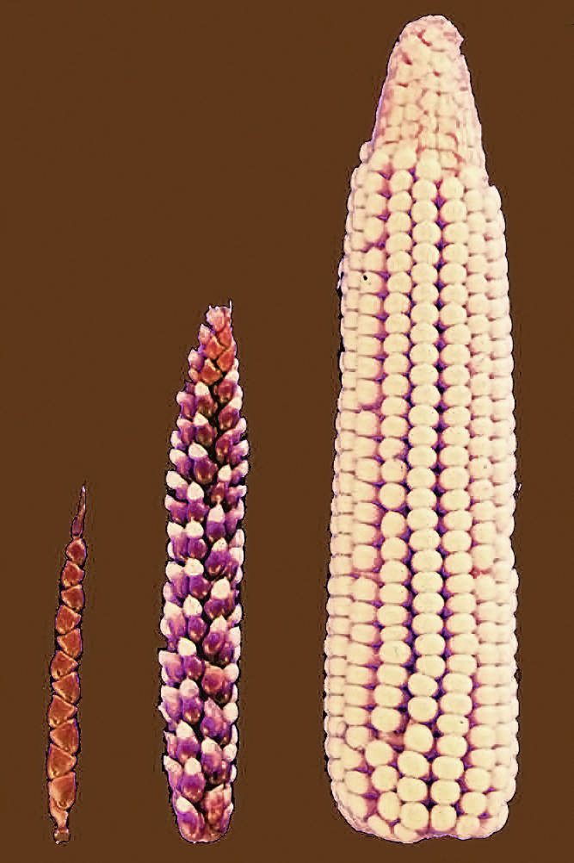
Why would we want to change a crop plant’s phenotype?
Create edible crops
"File:Cornselection.jpg" by John Doebley is licensed under CC BY 2.5.
Notes:
Teosinte domesticated into corn. Focus on how teosinte is not edible or nutritious.
https://www.nsf.gov/news/news_summ.jsp?cntn_id=104207#:~:text=By%20selectively%20breeding%20each%20generation,the%20two%20to%20be%20related.

Slide 20
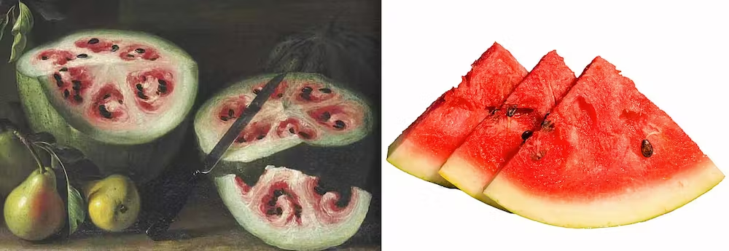
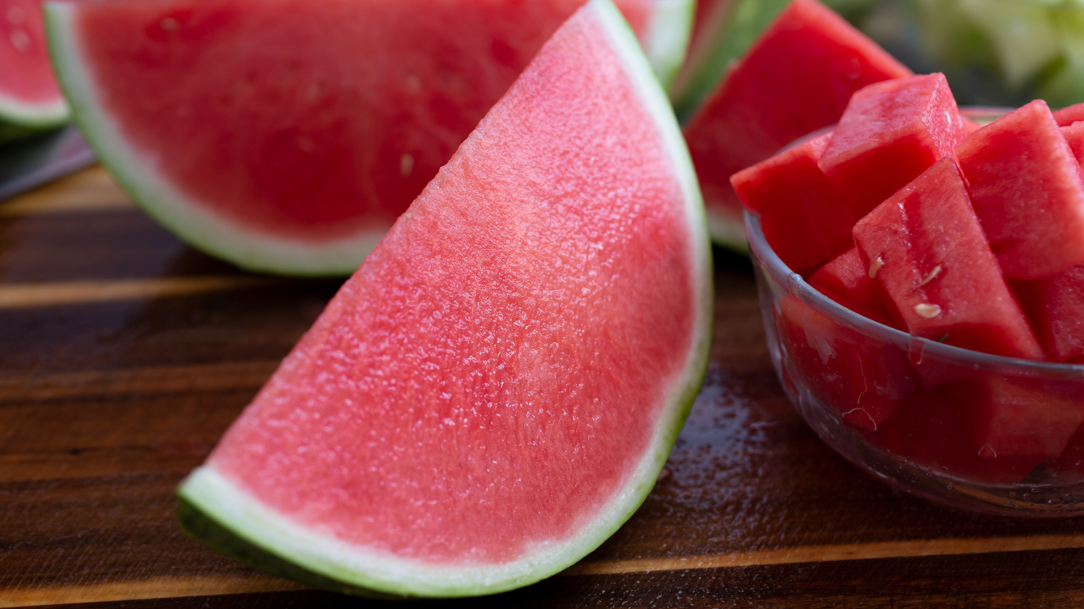
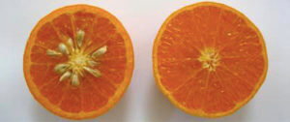
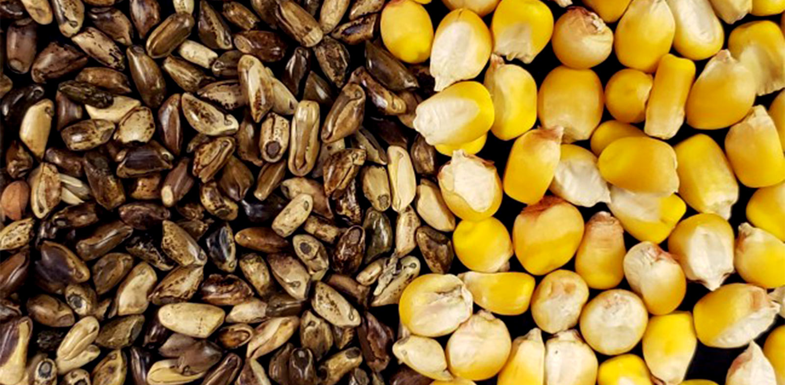
Create edible crops
Modern watermelons (right) look very different to their 17th-century ancestors (left).
Christies/Prathyush Thomas, CC BY
https://www.tastingtable.com/863145/the-science-behind-seedless-watermelons/
https://geneticliteracyproject.org/2016/06/13/pasta-ruby-grapefruits-why-organic-devotees-love-foods-mutated-by-radiation-and-chemicals/
https://www.futurity.org/corn-teosinte-domestication-crops-crispr-2691252-2/
Notes:
Watermelon: bred over hundreds of years to maximize fruit and minimize seed and rind; seedless watermelon is triploid and does not produce functional seeds, making it more desirable to eat.
Grapefruit bred for smaller or no seeds
Teosinte domesticated into edible corn

Slide 21
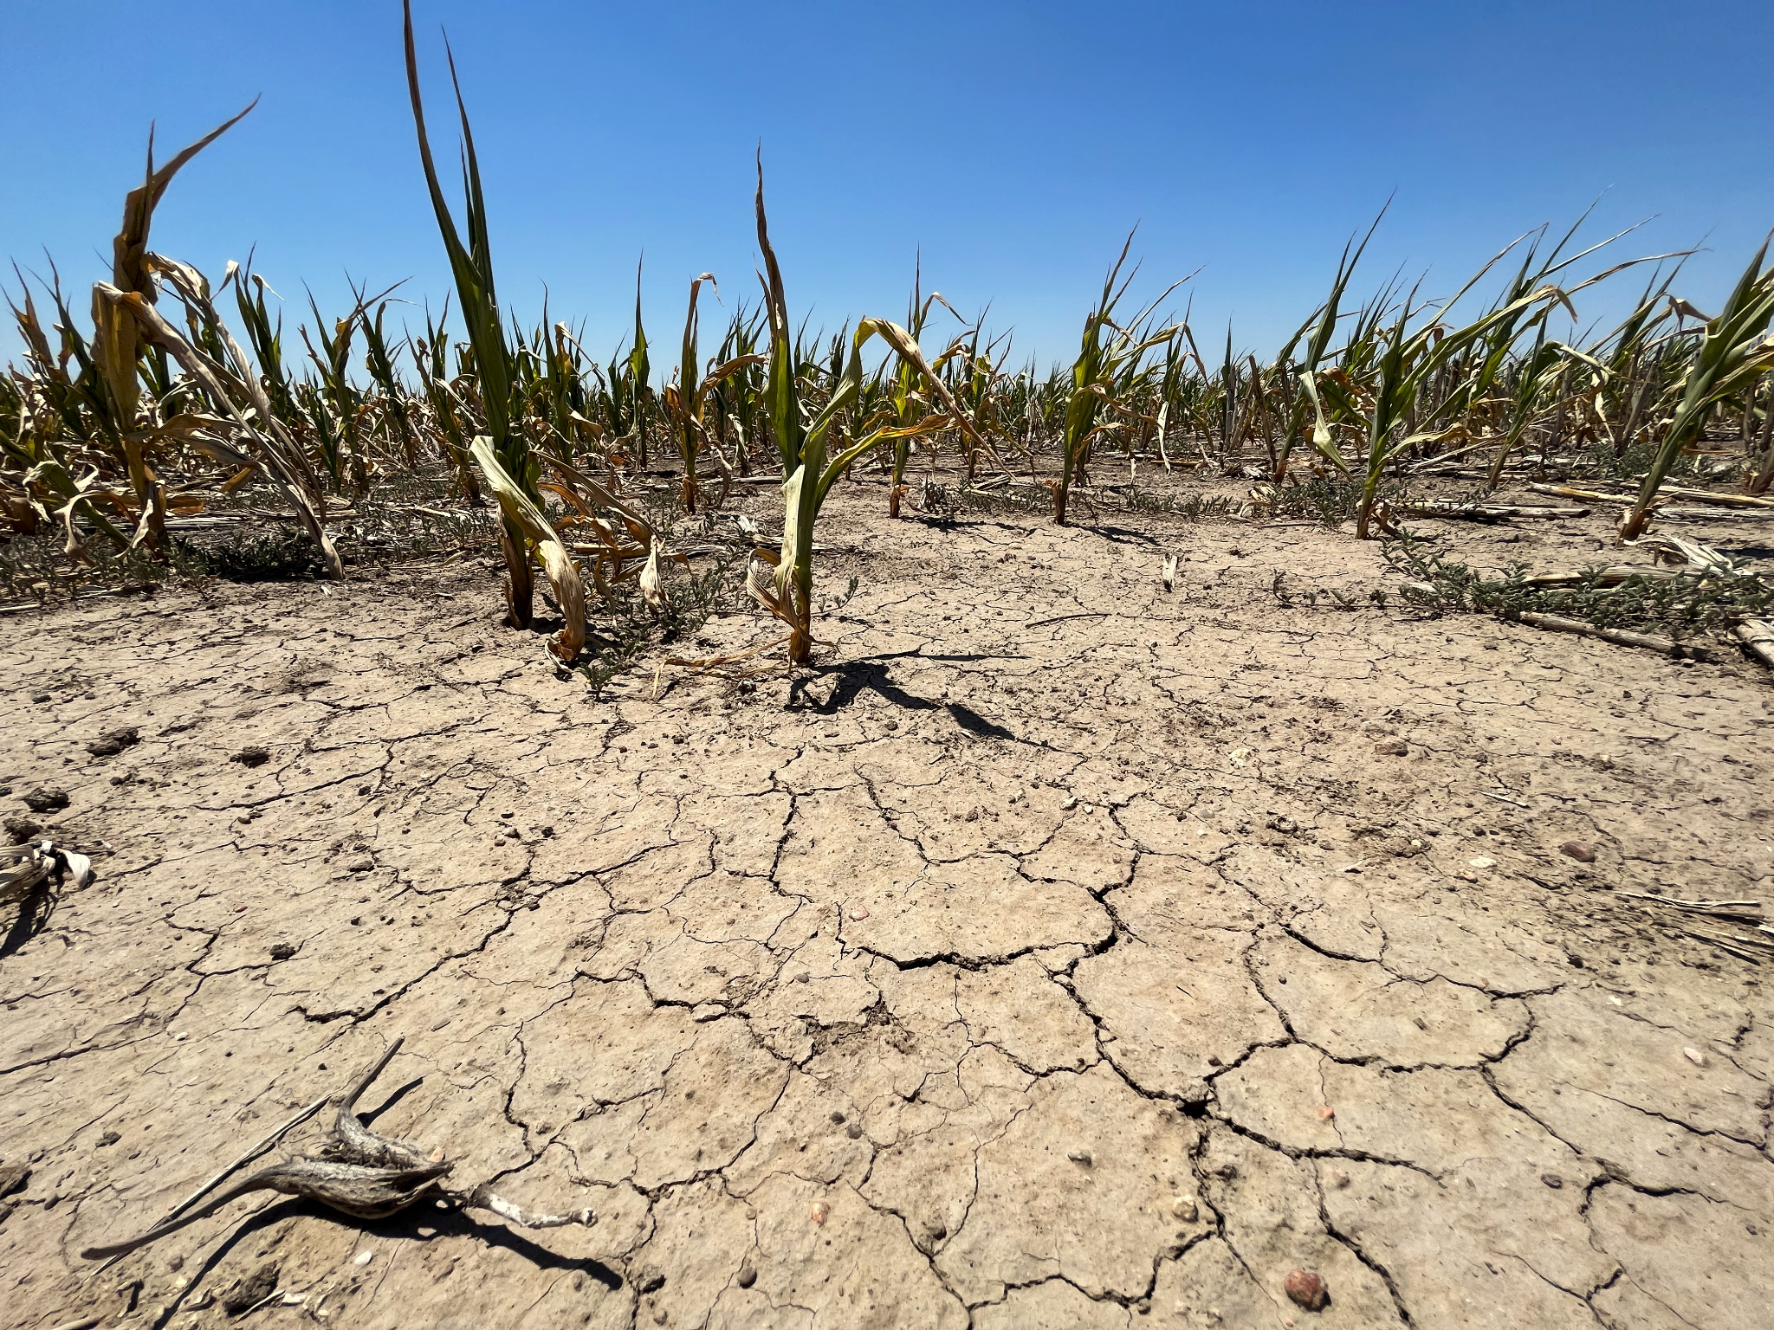
Why would we want to change a crop plant’s phenotype?
Create edible crops
Help crops resist climate stress
https://www.hppr.org/hppr-news/2022-09-20/how-the-drought-killing-kansas-corn-crops-could-make-you-pay-more-for-gas-and-beef
Notes:
Pictured: Corn crop in Western Kansas experiencing extreme drought stress

Slide 22
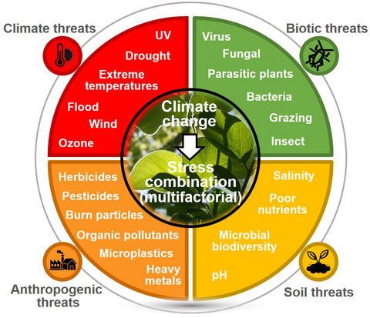
Resist environmental stress
https://onlinelibrary.wiley.com/doi/epdf/10.1111/tpj.15483
Notes:
Don’t try and go through every part of this - the purpose is to show the categories of stress that plants experience and to show that there are multiple specific threats within these.
Emphasize that climate change amplifies many of these problems, making them worse.

Slide 23
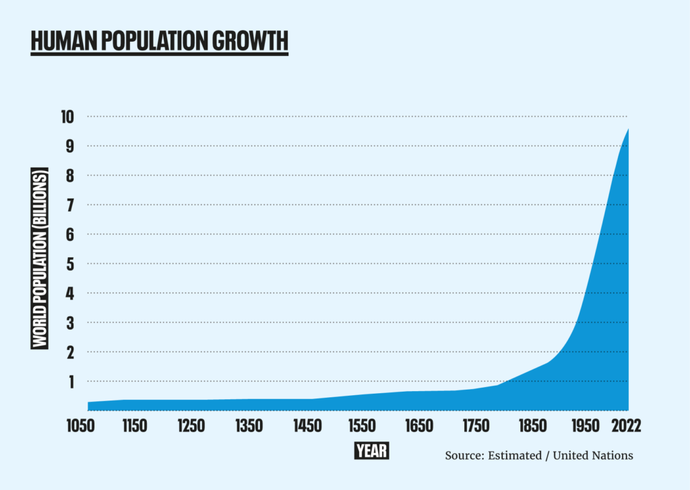
Why would we want to change a crop plant’s phenotype?
Create edible crops
Help crops resist climate stress
Feed more people
https://populationmatters.org/the-facts/
Notes:
This slide establishes that there are more and more people to feed now than ever before.
Graph: Human population growth (in millions) through 2022; note the exponential increase and therefore the need to feed those people

Slide 24
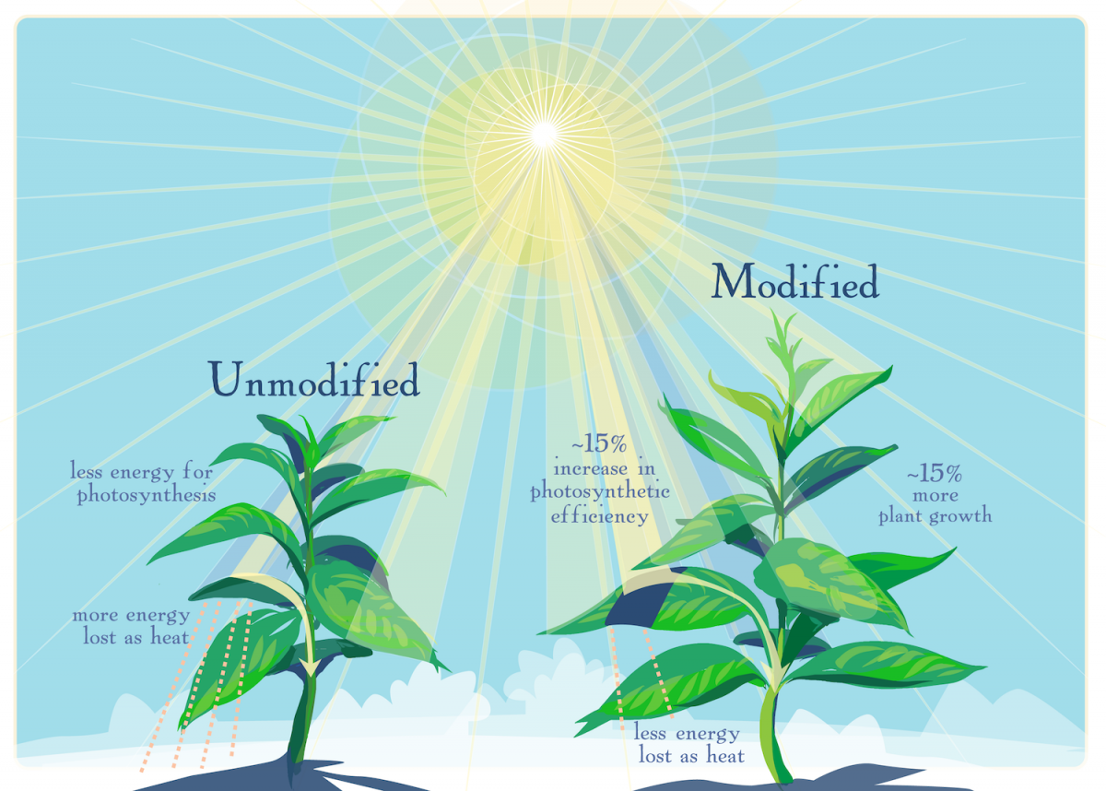
Feed more people
https://populationmatters.org/the-facts/
https://allianceforscience.org/blog/2018/02/gmo-crops-increasing-yield-20-years-progress-ahead/
Notes:
This slide establishes that changing crop plants can be a solution to this problem
Left: same graph as on previous slide
Right: Multiple examples of how genetic modification of a crop plant can increase its yield and feed more people

Slide 25
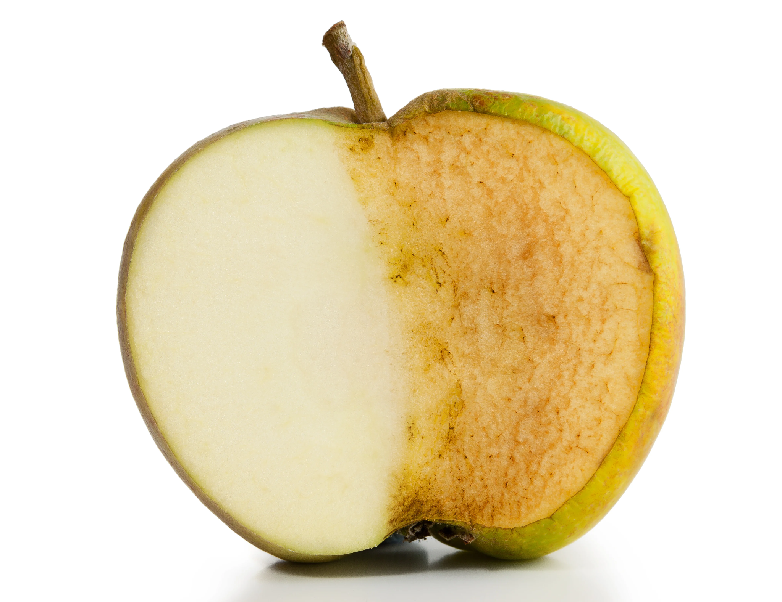
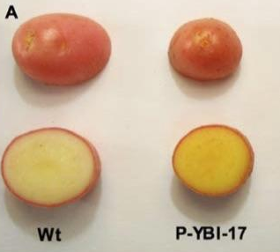
Why would we want to change a crop plant’s phenotype?
Create edible crops
Help crops resist climate stress
Feed more people
Improve nutrition and prevent spoilage
https://www.scientificamerican.com/article/experts-why-cut-apples-turn-brown/
https://www.genengnews.com/topics/translational-medicine/gmo-potatoes-provide-improved-vitamin-a-and-e-profiles/
Notes:
Left: apple that resists browning prevents spoilage reducing food waste
Right: golden potato modified to express vitamins A and E

Slide 26
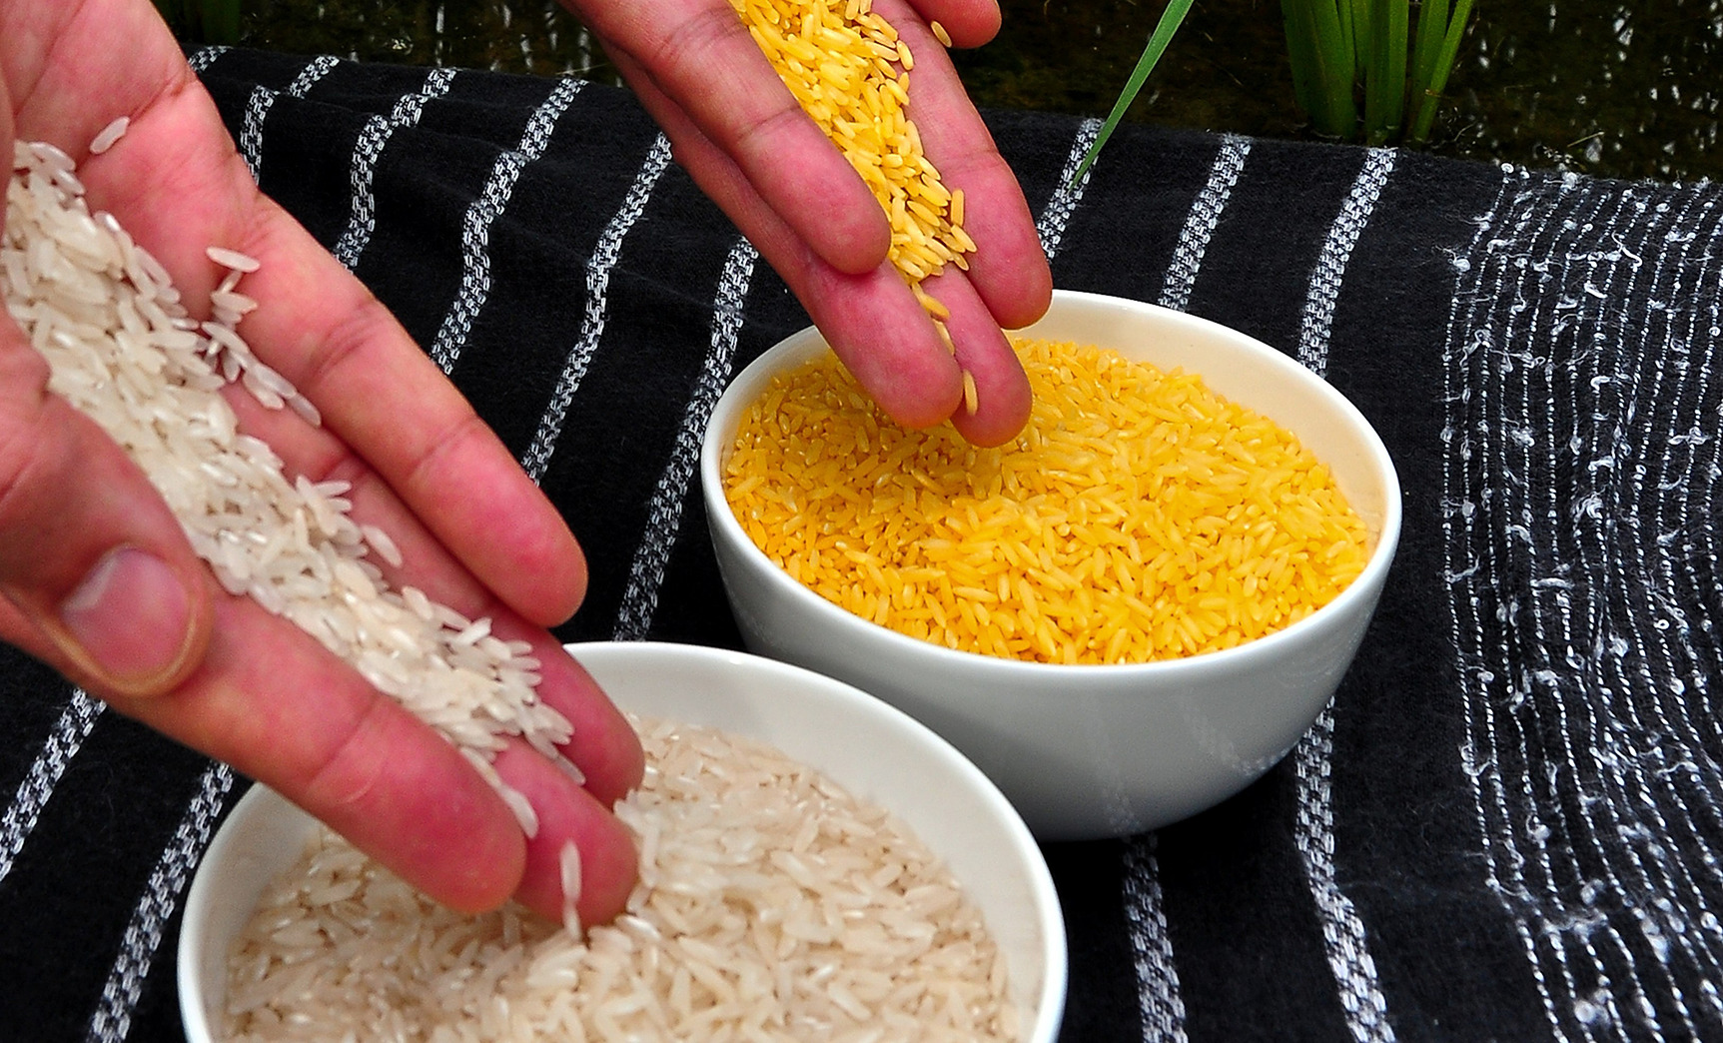
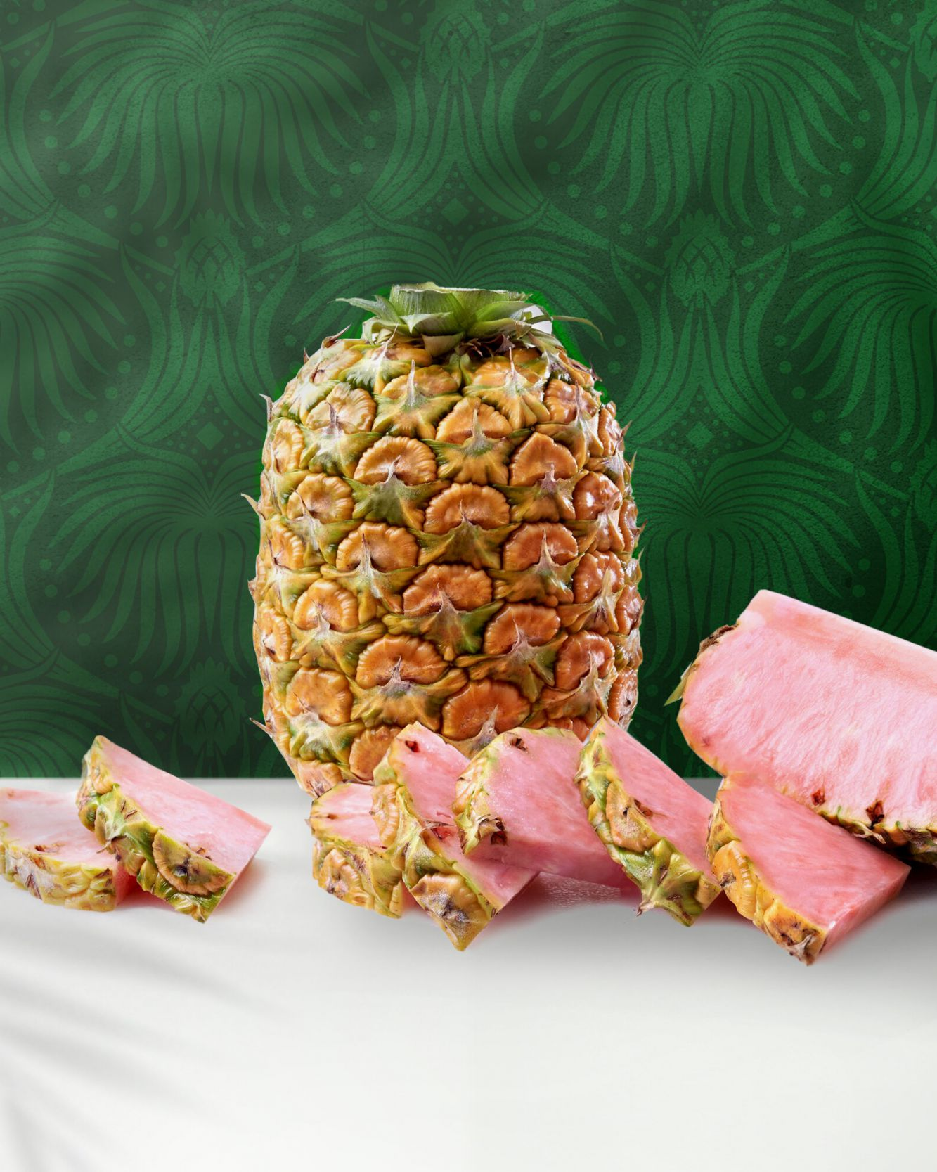
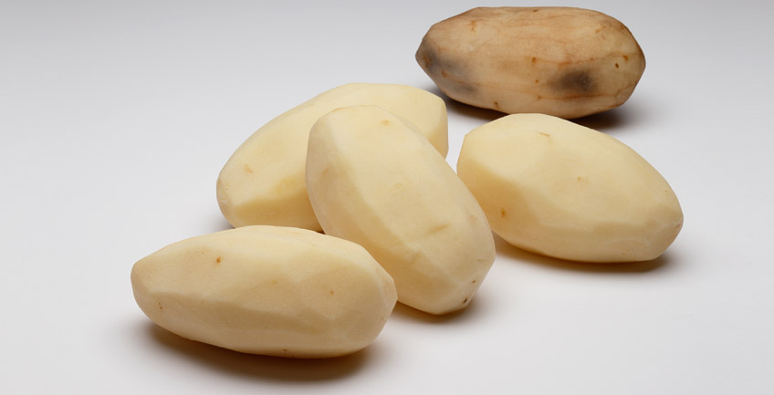
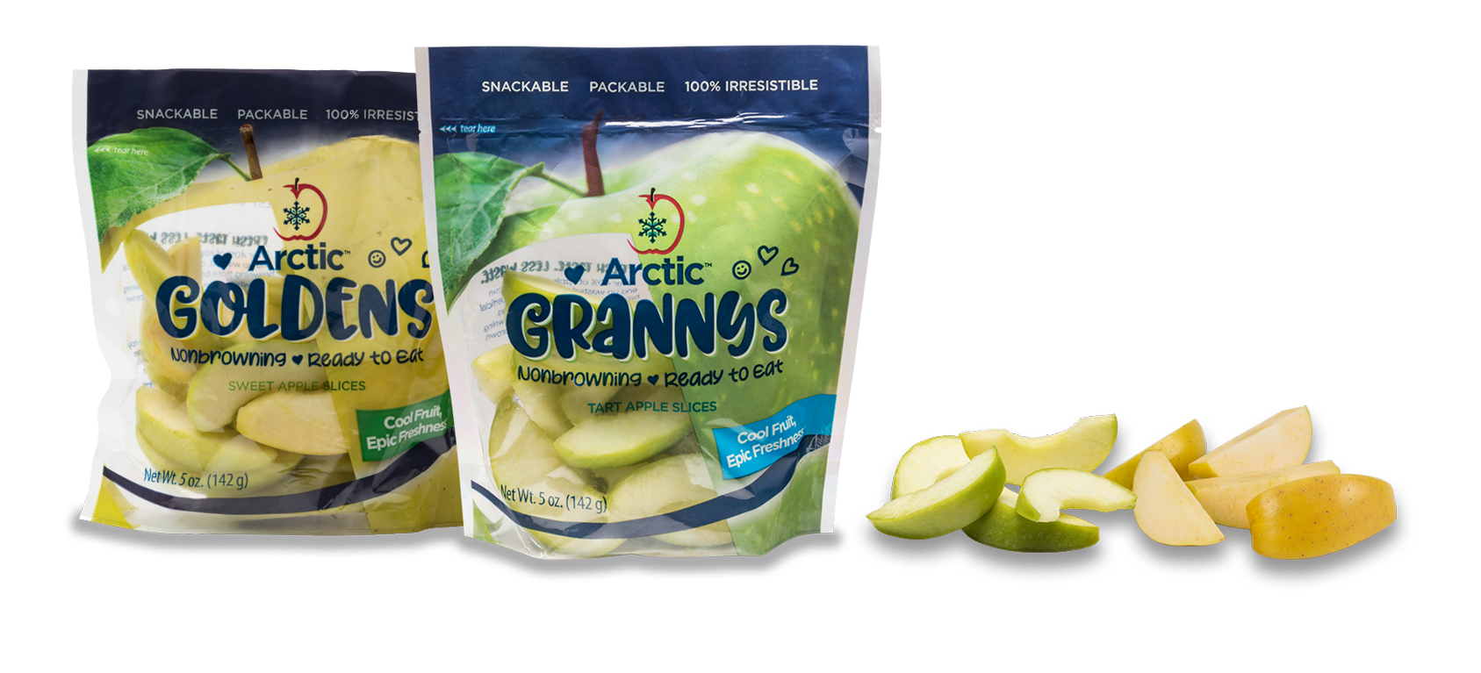
Improve nutrition and prevent spoilage
Golden rice - vitamin A
Pinkglow pineapple - lycopene
Innate potato - reduced blackspots, protection against disease
Arctic apple
Other products that resist spoilage, damage, or improve taste or nutrition
https://www.pnas.org/doi/10.1073/pnas.2120901118
https://arcticapples.com/
https://www.innatepotatoes.com/products/for-cultivate
https://www.pinkglowpineapple.com/
Notes:
This slide shows additional examples of genetically improved crops.
Golden rice - rice is a staple crop, but many who rely on it are deficient in nutrients like vitamin A. Golden rice expresses vitamin A.
Pinkglow pineapple - lycopene (found in tomatoes) in the diet may reduce risk of cardiovascular disease & certain cancers
Innate potato - reduces appearance of blackspots and protects against disease
Arctic apple - resists browning when cut
For more information on each of these crops, see the link below the corresponding picture.
For further information on genetic modification, see the following:
Additional resources: https://www.npr.org/sections/thesalt/2017/02/01/512633781/why-the-arctic-apple-means-you-may-be-seeing-more-gmos-at-the-store
This review has even more examples: https://www.frontiersin.org/articles/10.3389/fpls.2020.577313/full

Slide 27
Create Edible Crops
Modern watermelons (right) look very different to their 17th-century ancestors (left).
Christies/Prathyush Thomas, CC BY
https://www.tastingtable.com/863145/the-science-behind-seedless-watermelons/
"File:Cornselection.jpg" by John Doebley is licensed under CC BY 2.5.
Notes:
Teosinte has been domesticated into edible corn. Focus on how teosinte is not edible or nutritious.
https://www.nsf.gov/news/news_summ.jsp?cntn_id=104207#:~:text=By%20selectively%20breeding%20each%20generation,the%20two%20to%20be%20related.
Watermelon: bred over hundreds of years to maximize fruit and minimize seed and rind; seedless watermelon is triploid and does not produce functional seeds but is more desirable to eat.

Slide 28
Resist environmental stress
https://www.hppr.org/hppr-news/2022-09-20/how-the-drought-killing-kansas-corn-crops-could-make-you-pay-more-for-gas-and-beef
https://onlinelibrary.wiley.com/doi/epdf/10.1111/tpj.15483
Notes:
There are LOTS of possible environmental stresses; one example of climate stress (drought) is shown to the right, but there are many possibilities, and they are often combined.
Left: Don’t try and go through every part of this - the purpose is to show the categories of stress that plants experience and to show that there are multiple specific threats within these.
Emphasize that climate change amplifies many of these problems, making them worse.
Right: Corn crop in Western Kansas experiencing extreme drought stress

Slide 29
Feed more people
https://populationmatters.org/the-facts/
https://allianceforscience.org/blog/2018/02/gmo-crops-increasing-yield-20-years-progress-ahead/
Notes:
Feeding more people: consider asking students what is being shown in the graph. then connect this idea of population growth to food insecurity - we don’t have more land to grow plants, but we can increase growth on the same amount of land. Yield = how much food per plant. (shown in the image on the right - plants can be modified to increase yield)
This slide establishes that there are more and more people to feed now than ever before and that changing crop plants can be a solution to this problem
Graph: Human population growth (in millions) through 2022; note the exponential increase and therefore the need to feed those people
Image on right: Multiple examples of how genetic modification of a crop plant can increase its yield and feed more people

Slide 30
Improve nutrition and prevent spoilage
Golden rice - vitamin A
Pinkglow pineapple - lycopene
Golden potato - vitamins A and E
Arctic apple
Other products that resist spoilage, damage, or improve taste or nutrition
https://www.pnas.org/doi/10.1073/pnas.2120901118
https://www.genengnews.com/topics/translational-medicine/gmo-potatoes-provide-improved-vitamin-a-and-e-profiles/
https://arcticapples.com/
https://www.pinkglowpineapple.com/
Notes:
This slide shows additional examples of genetically improved crops.
Golden rice - rice is a staple crop, but many who rely on it are deficient in nutrients like vitamin A. Golden rice expresses vitamin A.
Pinkglow pineapple - lycopene (found in tomatoes) in the diet may reduce risk of cardiovascular disease & certain cancers
Golden potato - produces vitamins A and E in this staple crop
Arctic apple - resists browning when cut
For more information on each of these crops, see the link below the corresponding picture.
For further information on genetic modification, see the following:
Additional resources: https://www.npr.org/sections/thesalt/2017/02/01/512633781/why-the-arctic-apple-means-you-may-be-seeing-more-gmos-at-the-store
This review has even more examples: https://www.frontiersin.org/articles/10.3389/fpls.2020.577313/full

Slide 31
So… how do we achieve these results??
Activity: Brainstorming
Choose your favorite fruit or vegetable. Do not choose tomato (you’ll see why later!)
Consider changes that would improve specific aspects of this fruit or vegetable. What would you want to change?
Notes:
There are lots of possible answers, such as sweeter fruits, higher yield, pest resistance, drought tolerance, brighter color, longevity, etc.

Slide 32
So… how do we achieve these results??
But how do we achieve these results?
Need to change traits… How do we change attributes or traits?
In genetics, what do we call the way that something looks?
Notes:
Answer: we need to change the phenotype

Slide 33
How can we change a crop plant’s phenotype?
Think back to the genetics review: how do we change an organism’s phenotype?
Notes:
Answer: to change a phenotype, we need to change the genotype

Slide 34
How can we change a crop plant’s genotype?
In small groups, brainstorm a list of ideas
Notes:
Brainstorm ideas as a class or think-pair-share
(Some possible solutions on the next slide)

Slide 35
How can we change a crop plant’s genotype?
Some of the ideas you may have discussed:
Artificial selection
Natural selection
Genetic modification
CRISPR
Transgenes
Breeding
Mutation
https://gmoanswers.com/science-behind-gmos
Notes:
What do we know about changing genotypes? How do we change a genotype when we are using artificial selection and cross-breeding techniques? Make sure they are understanding that the phenotype is what is actually being selected for, and the genotypes associated with these phenotypes are not understood in historical breeding.

Slide 36
Inheritance
P generation
RR
red flowers
x
rr
yellow flowers
100% R
100% r
F1 generation
Rr
red flowers
Notes:
Note: the colors of the alleles (dominant/recessive) purposely do NOT correspond to the phenotype colors
Emphasize that in a monohybrid cross, we’re only following a single trait (i.e., breeding for flower color), but these genes are on chromosomes, and the whole background genotype is also being affected - these events aren’t happening in isolation and lots of other genes are being taken along (or left behind) with the genes of interest.

Slide 37
Inheritance
F1 generation
Rr
red flowers
Self-pollination (monohybrid cross)
50% R
50% r
Eggs
RR
Rr
F2 generation
Sperm
Rr
rr
P generation
RR
red flowers
x
rr
yellow flowers
100% R
100% r
Notes:
Note: many crop breeding examples are not simple monohybrids - they’re breeding >1 trait or the trait is controlled by multiple genes (or both!)

Slide 38
How can we change a crop plant’s genotype?
What if there was a better way to achieve goals than breeding?
Spoiler: There is!
https://gmoanswers.com/science-behind-gmos

Slide 39
Genetic Modification: Discussion
What do you already know about GMOs?
What do you think it means for a food to be genetically modified?
What are your impressions of genetic modification? What are they based on?
What types of things have you heard about GMOs? Good or Bad…
Notes:
Provide some time for students to discuss these questions in small groups.
Answers on the next slide

Slide 40
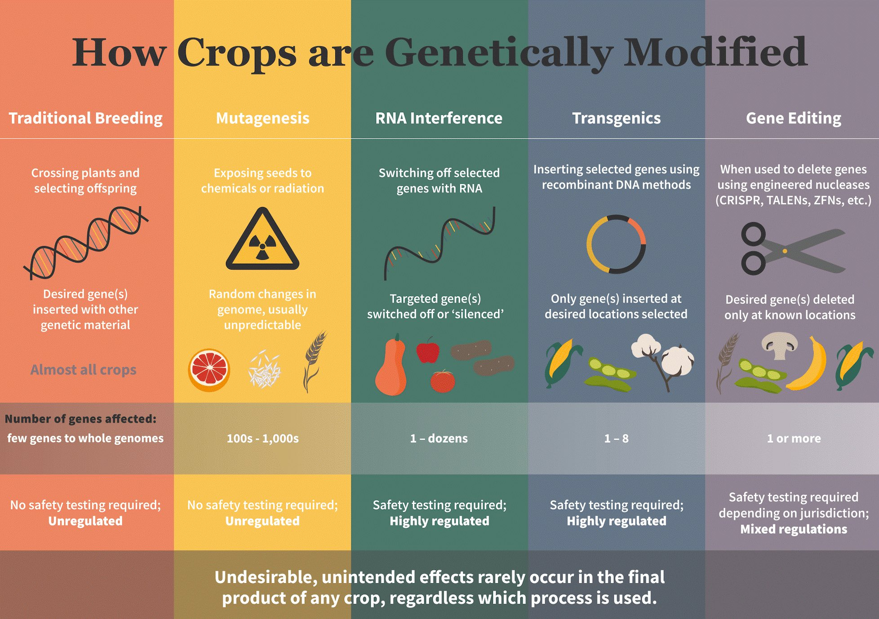
https://geneticliteracyproject.org/gmo-faq/what-are-mutagenized-crops-and-why-they-are-not-labeled-and-regulated/
Notes:
A different option of a graphic illustrating this idea can be found here: https://www.aces.edu/blog/topics/fruits-vegetables-urban/gmo-food-facts-bioengineered-crops/

Slide 41
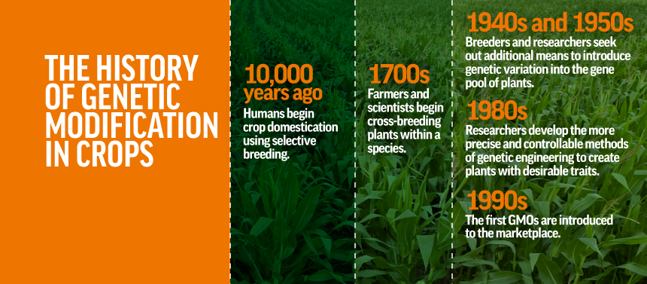
https://gmoanswers.com/science-behind-gmos

Slide 42
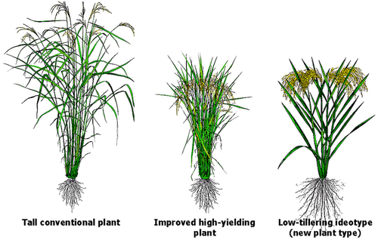
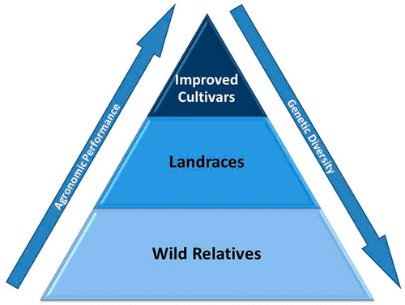
Artificial selection: Domestication and Breeding
Relies on random mutation
Humans select plants with advantageous traits
Possible disadvantages:
Slow
Potentially selects against other valuable traits like disease & pest resistance
https://pubs.acs.org/doi/10.1021/jf305531j
Notes:
Take-home message: this technique is cost effective and has been used for thousands of years. But it takes a long time, relies on existing variability, adn selects for less variability in these improved cultivars (often at the cost of beneficial alleles that are unknowingly being bred out)

Slide 43
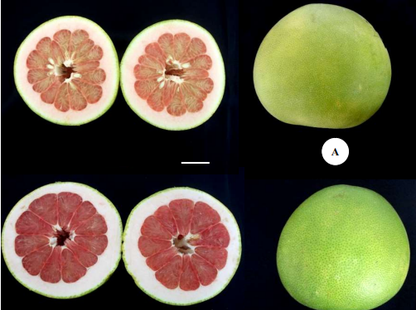
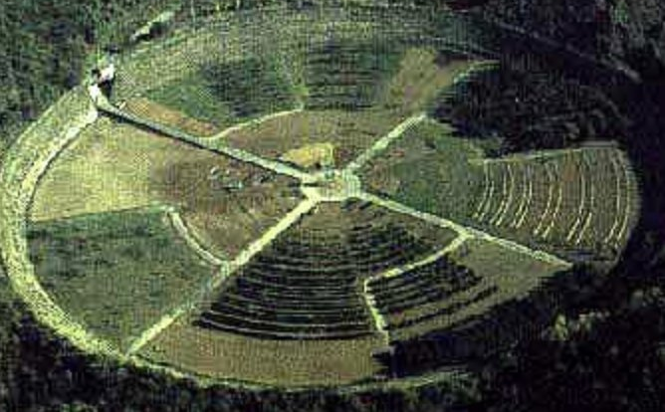
Genetic Engineering
Mutagenesis
https://www.semanticscholar.org/paper/Seedless-fruit-pummelo-induced-by-Gamma-Ray-Fruit-Mariana-Arisah/5c498d1ccc3510b691d6aecbc5975add29ca441c Fig. 1
Transgenic Plants
Gene Editing
https://www.aces.edu/blog/topics/fruits-vegetables-urban/gmo-food-facts-bioengineered-crops/
@AgBioWorld twitter
Notes:
Images to the right: above - Seedless pummelo induced by Gamma Ray irradiation in 2016 (we still use this technology today!)
Bottom - Gamma radiation field in Japan, aerial view. Most of the plants are dead due to the irradiation. Note: the radioactive rod is buried in the center of the circle, and plants are planted in concentric circles around it. The radiation dose decreases as distance increases. Induces all sorts of mutations, many of which are lethal. Some have desirable phenotypes. Seeds from these are collected, and offspring are cultivated. **these offspring are not radioactive; they simply have genetic changes that were induced by the radiation exposure in the parent**

Slide 44
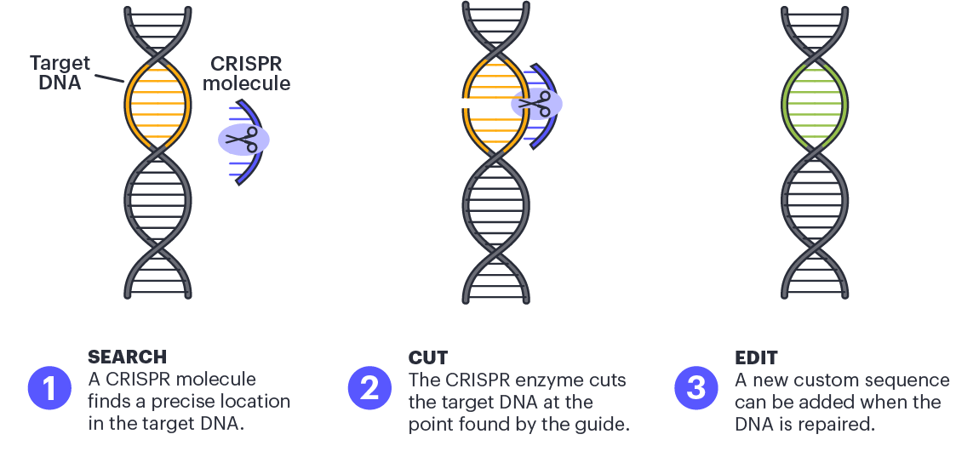
CRISPR
https://innovativegenomics.org/education/digital-resources/what-is-crispr/
Notes:
CRISPR is one way that precise genome editing can be performed in plants!
The target region of DNA (orange) is precisely edited or removed to yield a changed version (green)

Slide 45
CRISPR
https://www.eurekalert.org/multimedia/762010
Notes:
CRISPR is one way that precise genome editing can be performed in plants!
This figure shows how during the domestication of ancestral crops, plants carrying spontaneous mutations in domestication genes were selected for. The same genes can be targeted in wild plants by genome editing, resulting in a rapidly domesticated plant.

Slide 46
How can we change a crop plant’s genotype?
What if there was a better way to achieve goals than breeding?
Spoiler: There is!
https://gmoanswers.com/science-behind-gmos

Slide 47
Genetic Modification: Discussion
What do you already know about GMOs?
What do you think it means for a food to be genetically modified?
What are your impressions of genetic modification? What are they based on?
What types of things have you heard about GMOs? Good or Bad…
Notes:
Provide some time for students to discuss these questions in small groups.
Answers are provided on slide 40 (just go through them verbally quickly)

Slide 48
https://gmoanswers.com/science-behind-gmos

Slide 49
There Are Many Ways to Modify Plant Genomes
https://geneticliteracyproject.org/gmo-faq/what-are-mutagenized-crops-and-why-they-are-not-labeled-and-regulated/
Notes:
A different option of a graphic illustrating this idea can be found here: https://www.aces.edu/blog/topics/fruits-vegetables-urban/gmo-food-facts-bioengineered-crops/

Slide 50
So… how do we achieve these results??
Activity: Build a Better Tomato
Consider the tomato plant. Think about how it grows, how it tastes, what it’s used for, how it’s harvested, etc.
Consider any changes that would improve specific aspects of this fruit. Write down your ideas.

