Slide 1
Presentation materials for Plant Science Decadal Vision 2020 – 2030 Reimagining the Potential of Plants for a Healthy and Sustainable Future

Slide 2
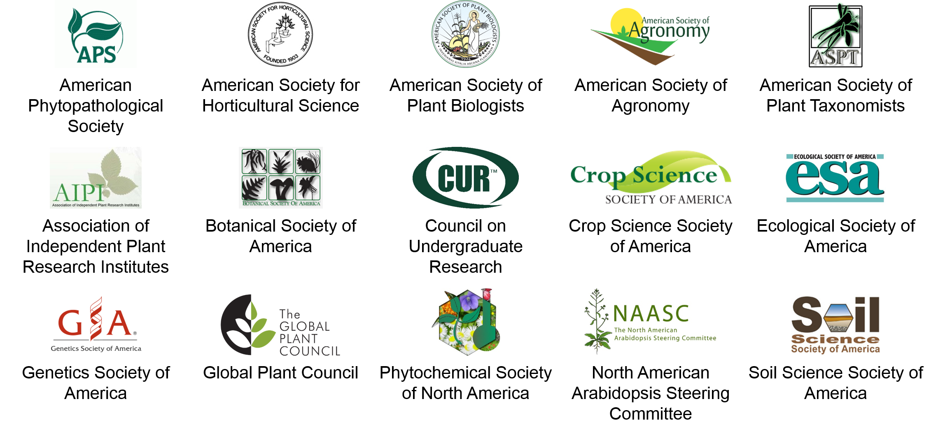
Notes:
The Plant Science Research Network, which led the development of the Decadal Vision, is an NSF-funded Research Coordination Network with representatives from 15 scientific societies that support plant science research and education, including the Ecological Society of America.

Slide 3
Notes:
About a year ago, the Plant Science Research Network brought together 50 plant scientists to discuss the future of research, training, and discoveries at the Plant Summit 2019, held at Biosphere II in Tucson. From that meeting, a writing team developed the Decadal Vision with specific recommendations to move forward with areas of plant science ripe for innovation, cultural change, and advocacy.
Plant Summit 2019 Rallying Cry:
Unite: Plant scientists
Inspire: New science
Enable: The future

Slide 4
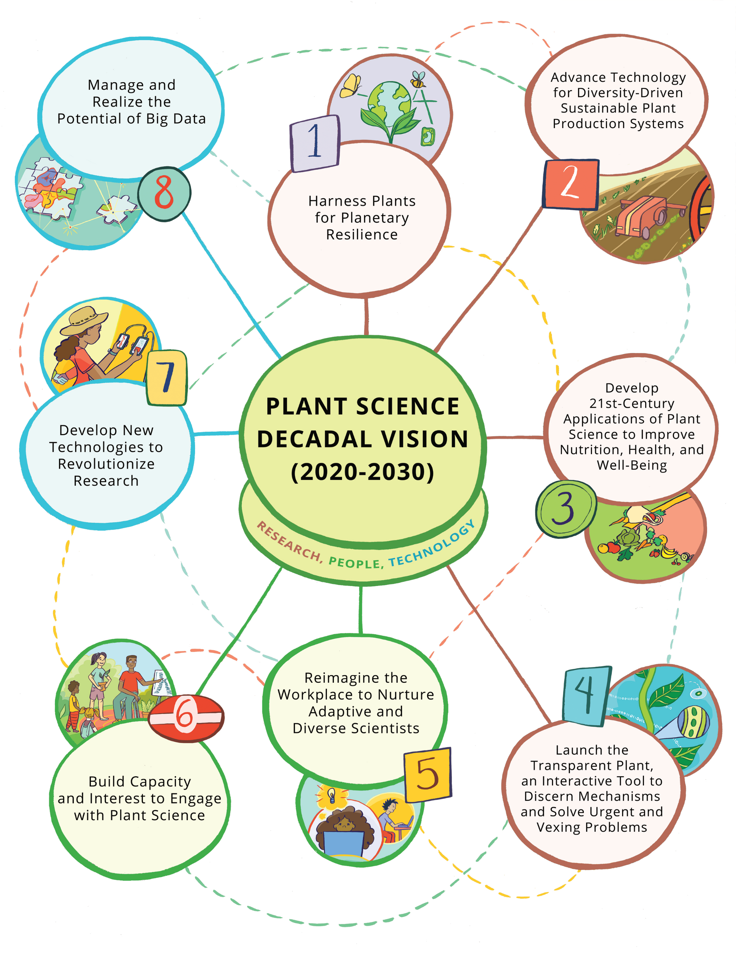
Illustrations by Kristyn Stickley, Kristyn Stickley Illustration 2020

Slide 5
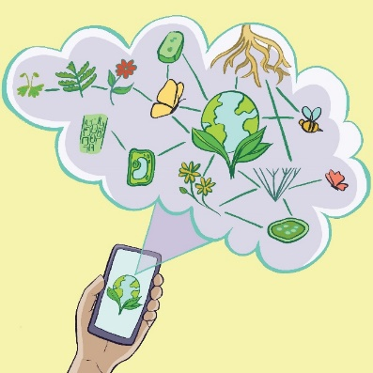
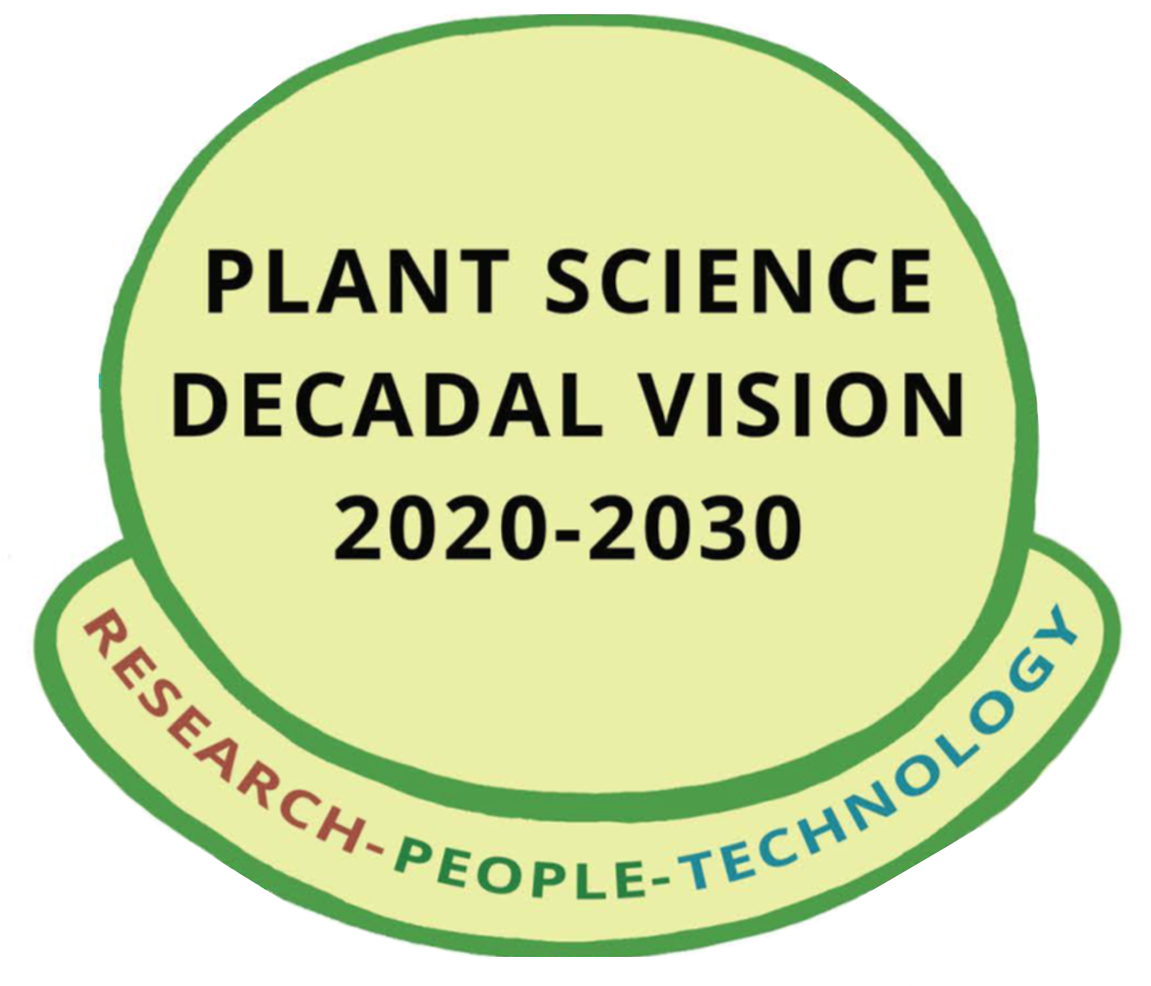
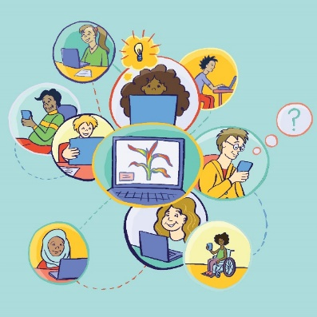
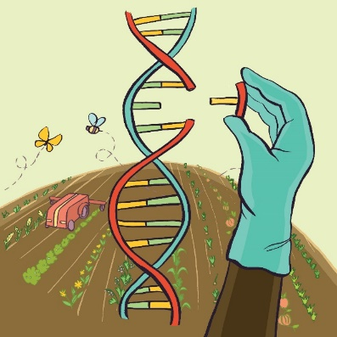
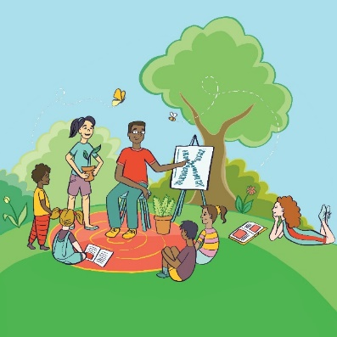
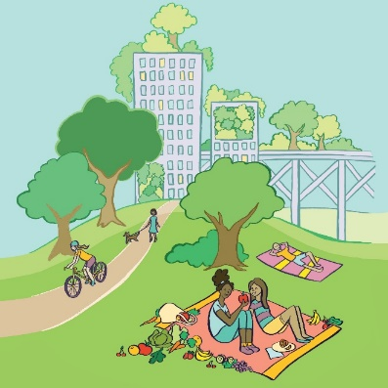
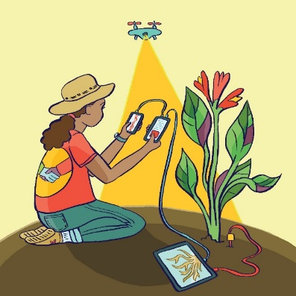
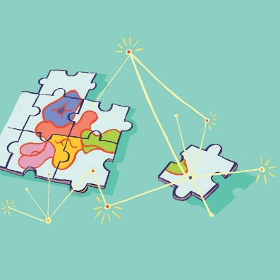
Illustrations by Kristyn Stickley, Kristyn Stickley Illustration 2020
Notes:
The Plant Science Decadal Vision has a central theme, which is that Research, People, and Technology must ALL be ADVANCED for plant science to succeed and grow over the next ten years. More than ever before, the future is about plants and how they can contribute to a sustainable future for humans, and indeed all life, on the planet.

Slide 6
Harness Plants for Planetary Resilience
Advance Diversity-Driven Plant Production
Develop Applications of Plant Science to Improve Nutrition, Health, and Well-Being
Launch the Transparent Plant, an Interactive Tool
Reimagine the Workplace to Nurture Adaptive and Diverse Scientists
Build Capacity and Interest to Engage with Plant Science
Develop New Technologies to Revolutionize Research
Manage and Realize the Potential of Big Data

Slide 7
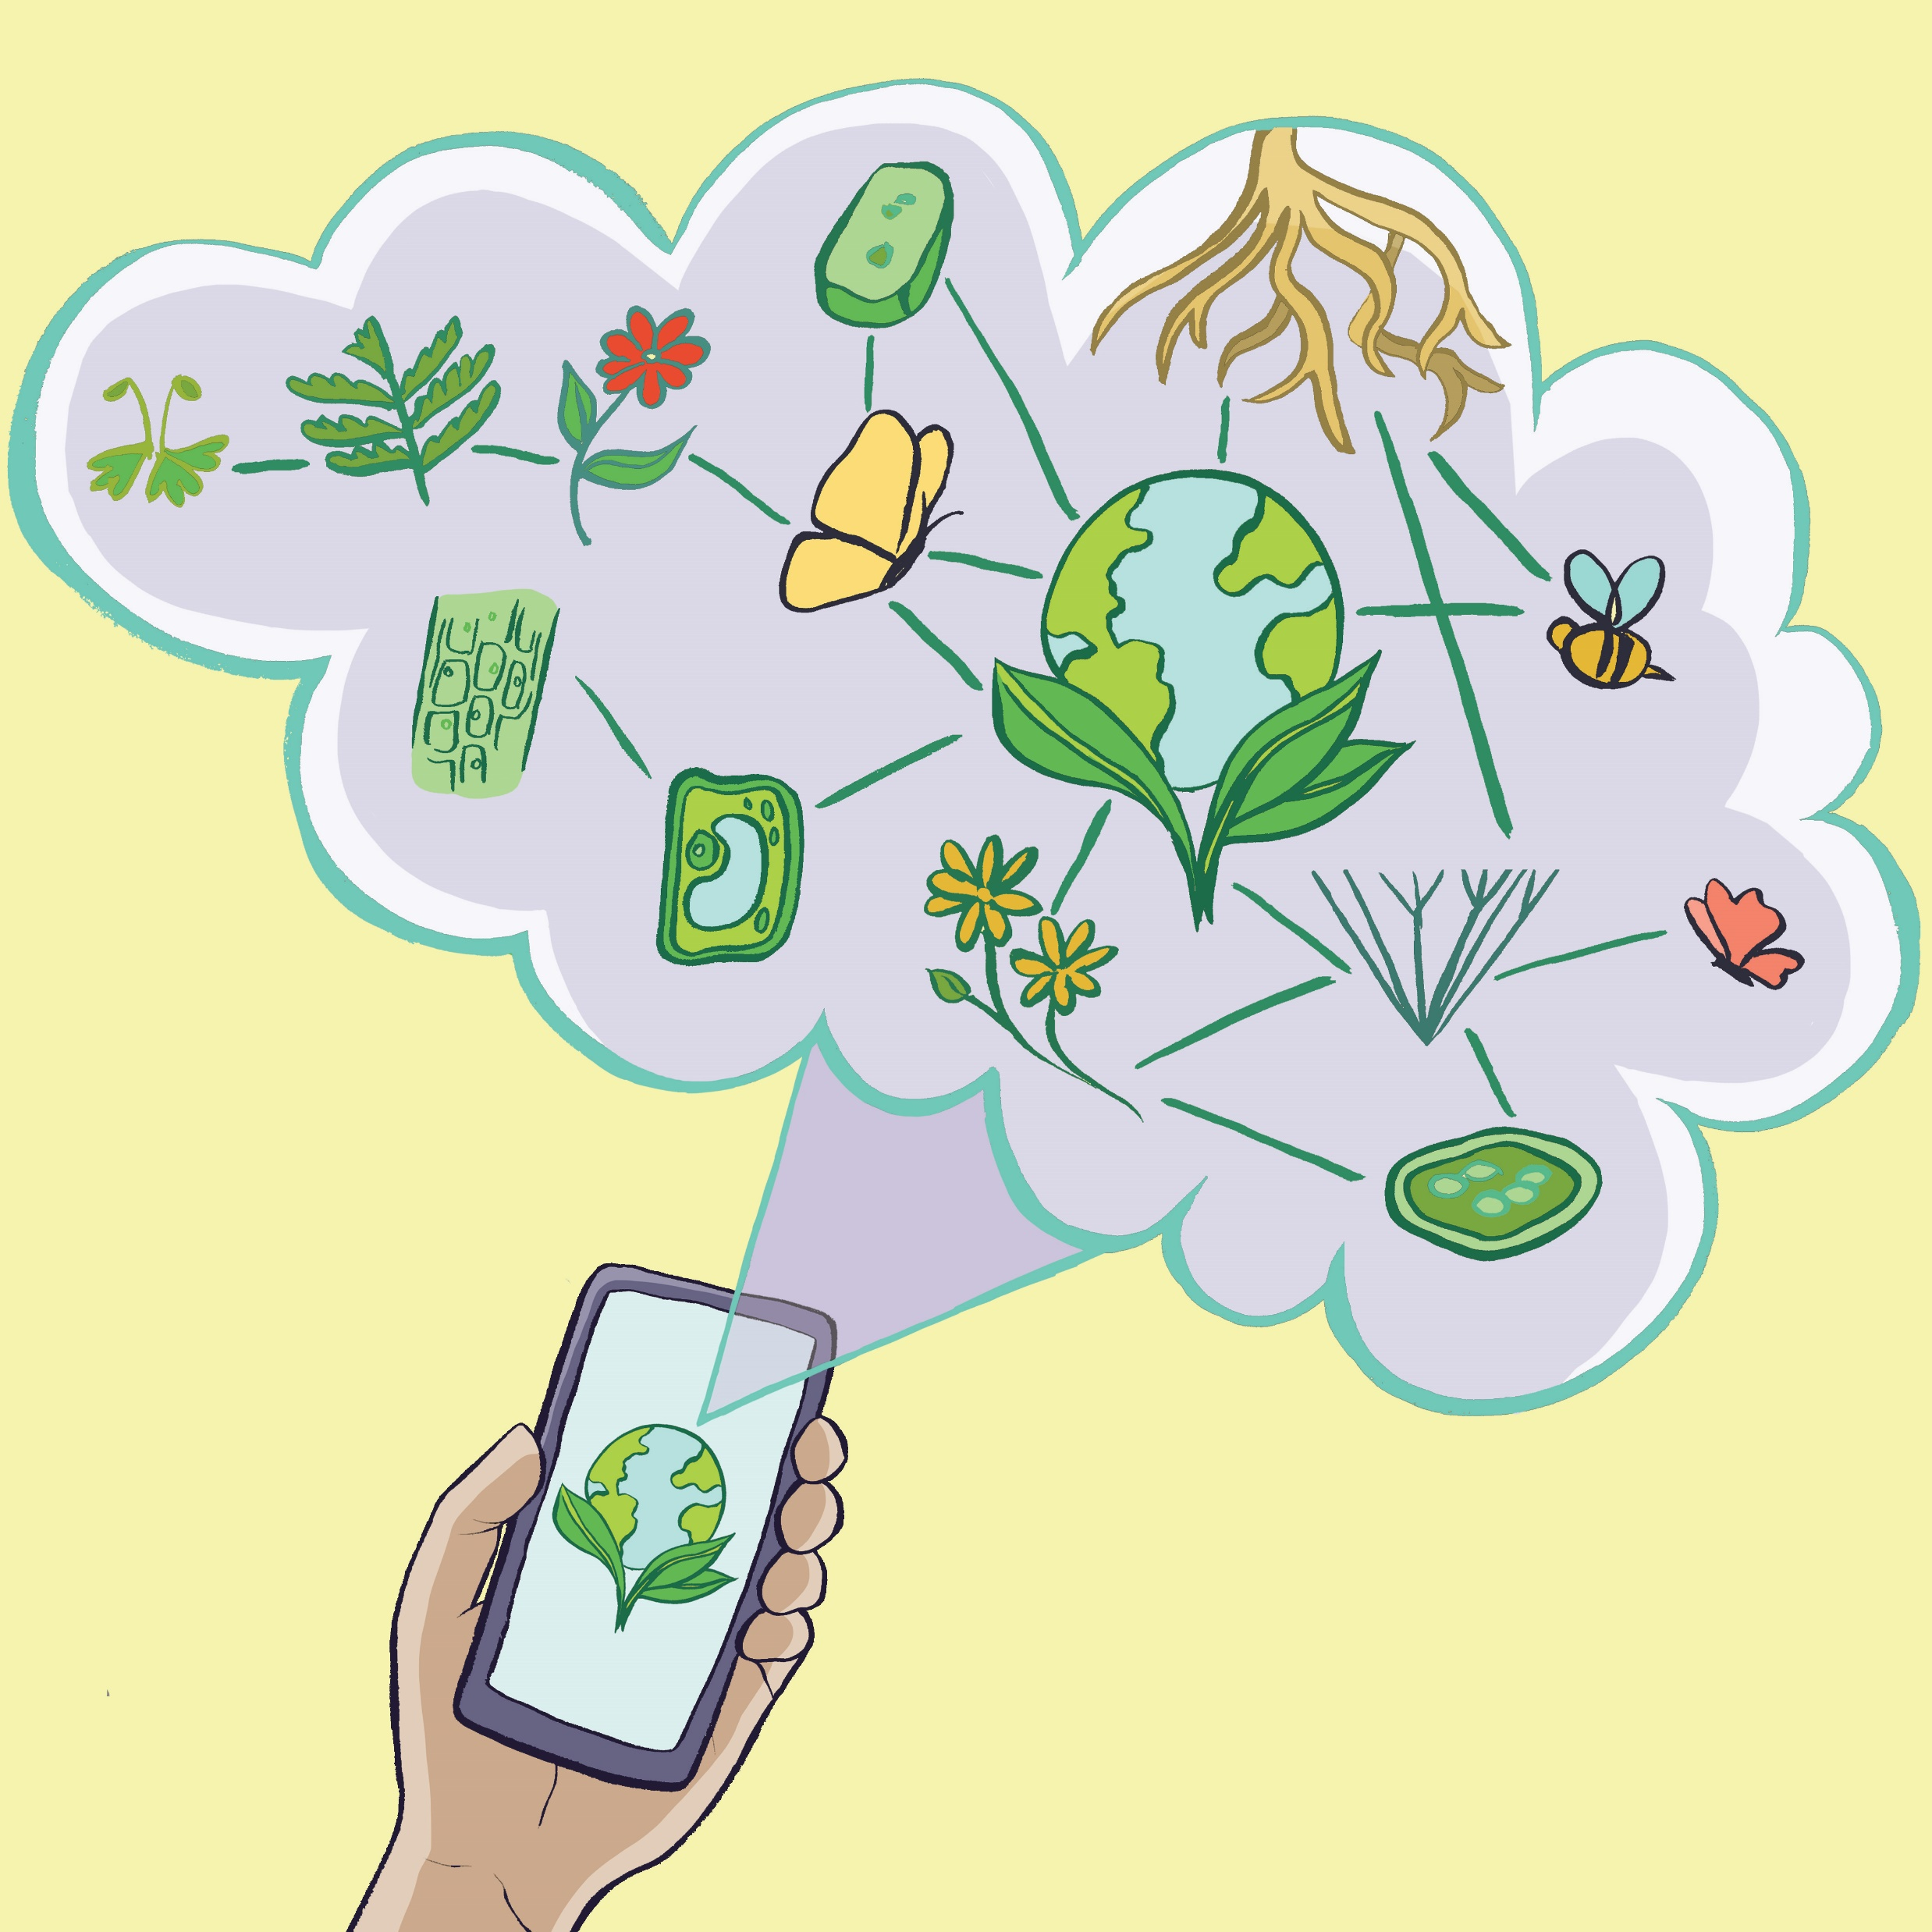
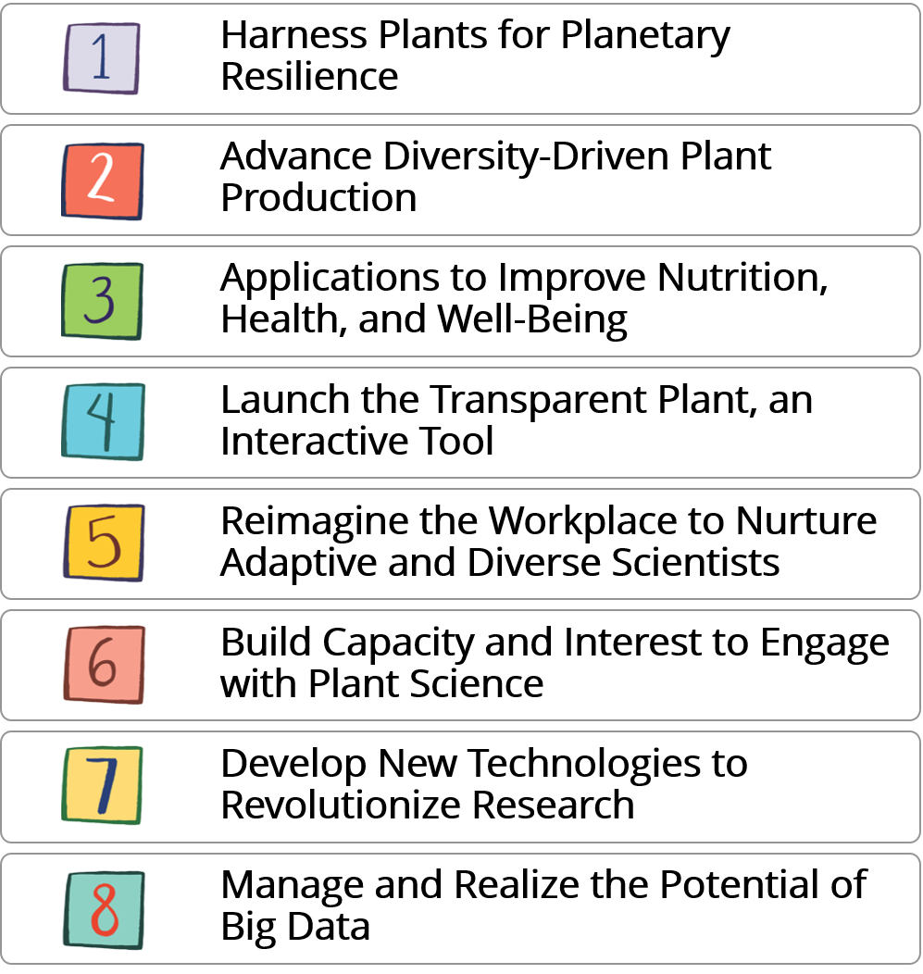
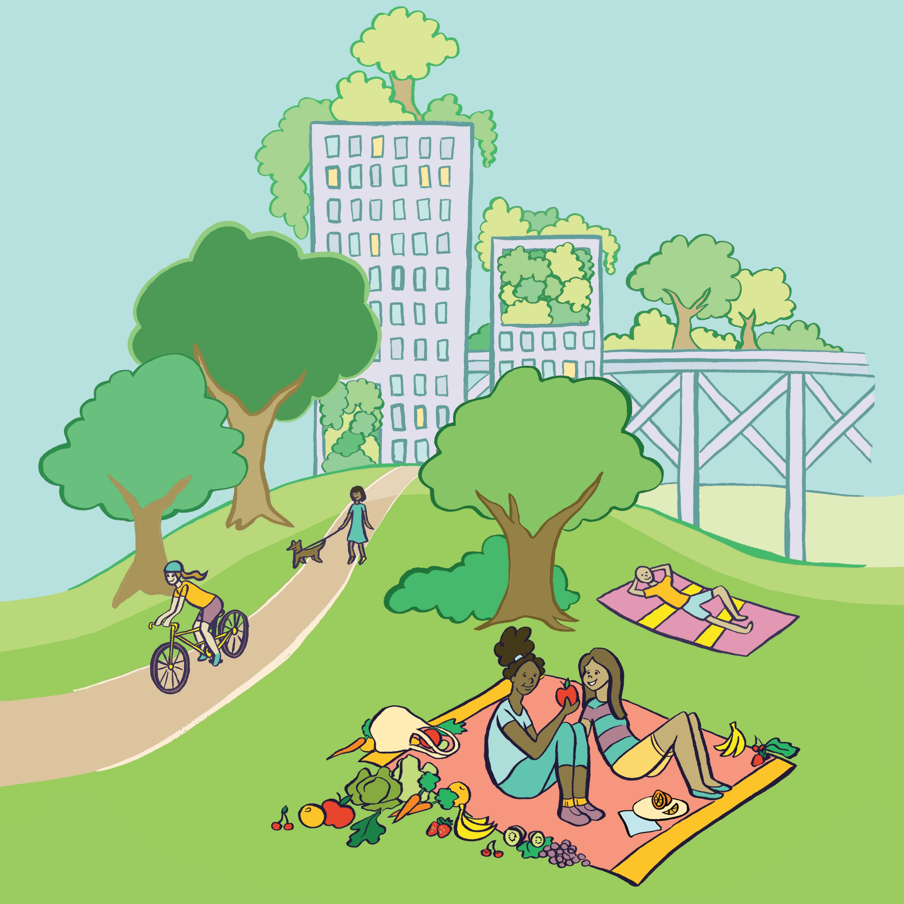
RESEARCH – PEOPLE – TECHNOLOGY
Kristyn Stickley Illustration 2020
Notes:
8 specific and interconnected goals that address Research, People, and Technology
Over the next few slides I'll tell you briefly about the recommendations in the four research goals.

Slide 8
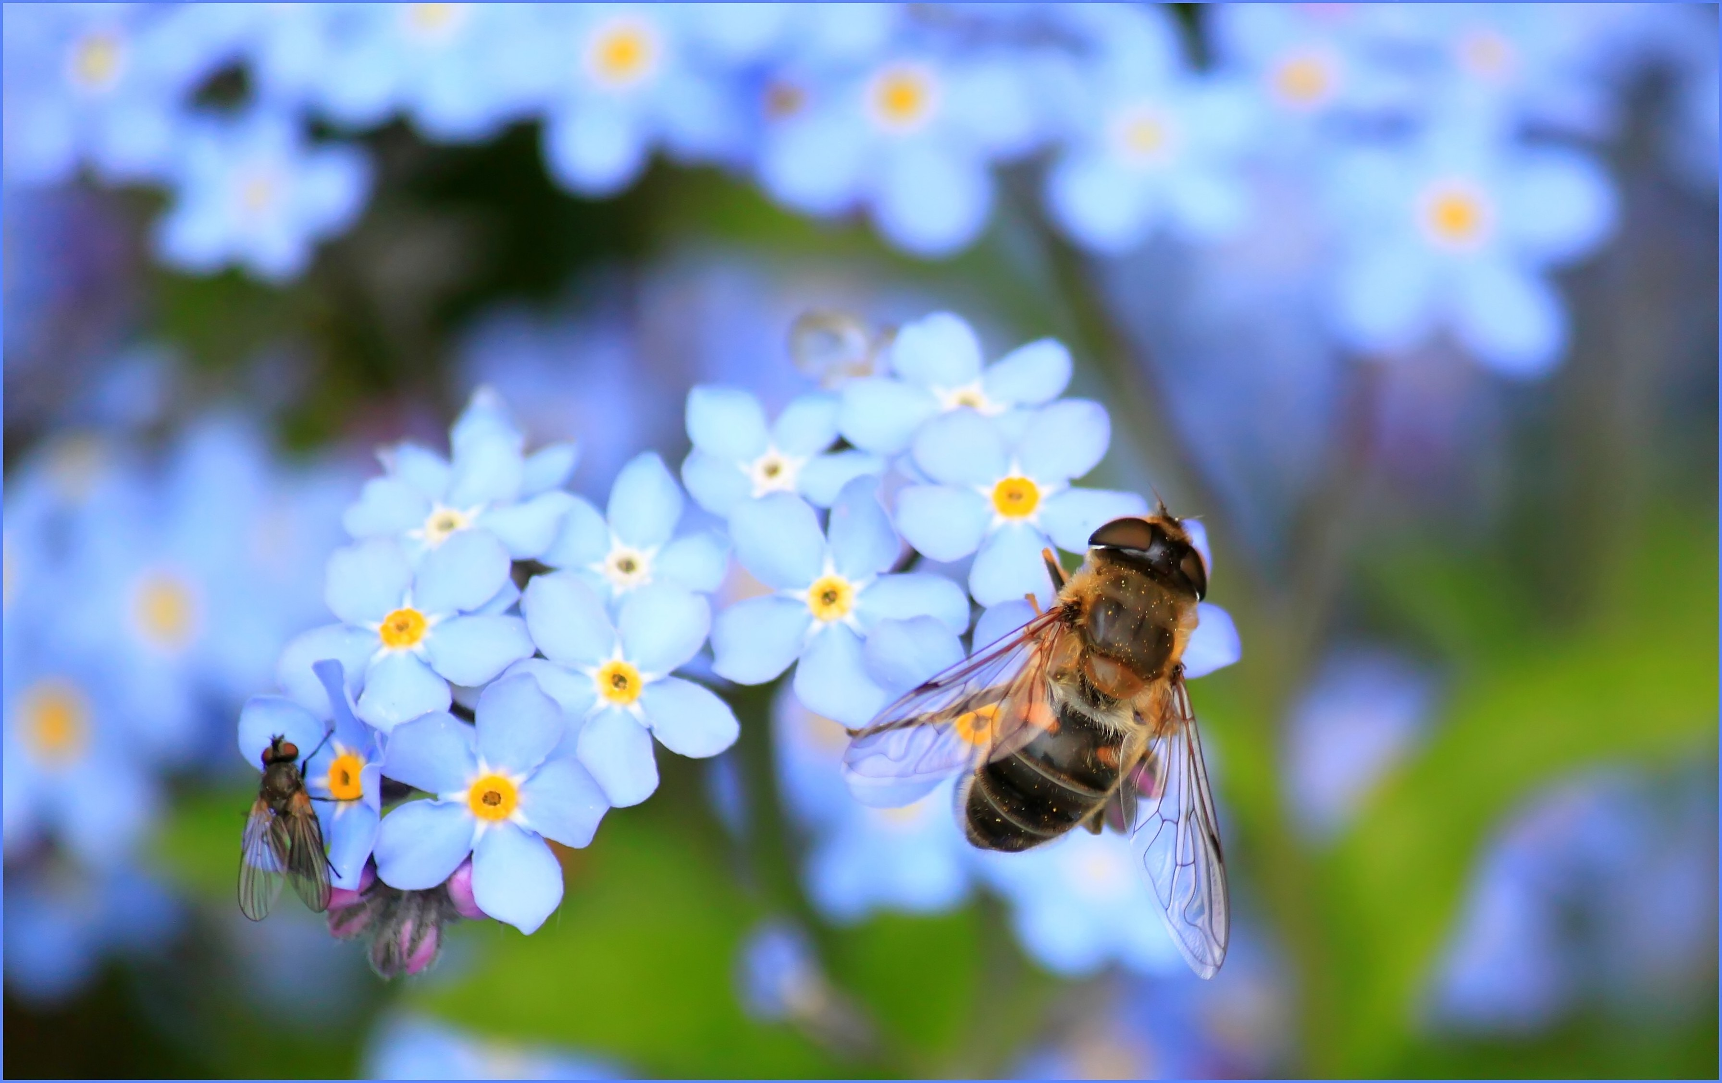
Harness Plants for Planetary Resilience
Predict ecological and evolutionary changes
Understanding the assembly of biological communities
Notes:
Goal 1 – “Harnessing plants for planetary resilience”
This goal will help scientists better understand and predict ecological and evolutionary changes.
And understanding the assembly of existing and novel biological communities and how associations vary across time scales.
Use Machine Learning and Technology to Predict Ecological and Evolutionary Changes

Slide 9
Action Plan
Develop well-resolved phylogenetic trees for all plants, including algae, and their associated biota; these phylogenies will form the basis of an online global catalogue that will be unprecedented in depth and value.45 One valuable outcome of this effort will be a comparative framework for detecting how genotype–phenotype associations vary across time scales, exploring how genes evolve along phylogenies and in turn affect phenotypes, and understanding the assembly of existing and novel biological communities.
Strategically select a broad set of phylogenetically and ecologically diverse plant lineages for in-depth analysis of their morphology, anatomy, physiology, ecology, genomics, and genetics in their natural environments. Of key consideration should be their additional feasibility as experimental systems for testing hypotheses for mechanisms of diversification and adaptation under controlled conditions.
Explore, identify, and characterize as-yet undiscovered plant-associated biota, from mutualistic to pathogenic, to understand through floristic and systematic studies their contributions to biological diversity. Such information is invaluable in addressing problems arising from emerging pests and diseases and unfavorable interactions caused by introduced and invasive species. Leveraging information about mutualists across scales from microbes to macrobes (e.g., herbivores, pollinators) will better support efforts to mitigate, reverse, and adapt to ecological and environmental changes.
Enhance global mapping of species distributions and threats to elucidate trends and enable predictions of near-term vulnerabilities. Similar efforts to classify, map, and assess vulnerabilities of both natural and cultural plant communities are also imperative. Accurate risk assessment will be critical in slowing and perhaps reversing the impacts of human-mediated loss of biodiversity.
Develop efficient ways to mine centuries of scientific studies, biodiversity literature, and specimens and to integrate old and new data to develop useful ecological and evolutionary models that inform our understanding of current environmental degradation and the steps needed for successful mitigation and adaptation.
Although the accumulation of data stemming from Actions 1 through 5 will be invaluable, we must also use and manage these data (Goal 8) to push the boundaries of our knowledge of interspecies interactions, food webs, ecosystems, and biomes to understand and mitigate the effects of changing environments at all levels of biological organization from genes to the biosphere.
Notes:
Please don’t display this slide as is but rather highlight specific areas that would be relevant to the audience.

Slide 10
Advance Technology for Diversity-Driven Sustainable Plant Production Systems
Investments in crop system improvements
Crop innovation
Improving agroecology
Invent and deploy modern tools
Gene editing, synthetic biology, and plant breeding
Notes:
Goal 2: Advancing technology for diversity driven sustainable plant production systems.
Invent and deploy modern tools like
gene editing,
synthetic biology and
plant breeding.
…In the Decadal Vision report, we propose two far reaching research goals (or moonshots).

Slide 11
Advance Technology for Diversity-Driven Sustainable Plant Production Systems
Moonshots
Perennial Plants
Resilient Crops
Notes:
[14] In the Decadal Vision report, we propose two far reaching research goals (or moonshots).
Using perennial plants to develop more sustainable cropping systems. “Transforming Cropping Systems with New Perennials and Polycultures”
Building Resilient Crops for the Future by developing more drought and stress resilient plants. “Breaking the Water Habit by Building Resilient Crops for the Future”
Create new crops and enhance crops for resilience
Incorporate microbiomes
Perennial
More crop per drop – idea from the SoAR report (2019)

Slide 12
Action Plan
Identify and apply genetic mechanisms for crop resilience and increased productivity, without increasing the carbon footprint on the same acreage, to meet the needs of projected population growth while maintaining profitability and livelihoods for farmers and farmworkers.
Identify and develop alternative crops for domestication and production, including fiber-producing plants, assessing benefits and drawbacks in partnership with nutritionists, food scientists, and agricultural economists.
Diversify production in terms of crop rotation to increase resilience and economic return while reducing external energy inputs and securing nutritional output of farms.
Understand and apply phytobiome research to reduce plant disease, improve water efficiency and nutrient utilization, maintain soil health, and improve plant productivity.
Reduce use of agricultural water by 20% and fertilizer by 15% through cultural and management practices outlined in a recent National Academy of Sciences report, as well as through genetic improvements.
Implement measures, including novel robotic technologies, to dramatically reduce use of fungicides and pesticides in plant production.
Notes:
Goal 2: Advancing technology for diversity driven sustainable plant production systems.
Invent and deploy modern tools like
gene editing,
synthetic biology and
plant breeding.
…In the Decadal Vision report, we propose two far reaching research goals (or moonshots).

Slide 13
Develop Applications of Plant Science to Improve Nutrition, Health, and Well-Being
Plants are sources of medicines, molecular factories, and the foundation of green infrastructure
Notes:
Full title: Goal 3: Develop 21st-Century Applications of Plant Science to Improve Nutrition, Health, and Well-Being
[15] How do plants work for humanity?
Goal three challenges us to develop 21st century applications of plant science to improve health, nutrition and well being.
Gita will discuss an example in her talk.
Plants are
Sources of medicines – Taxol example
Molecular factories
Foundation of green infrastructure

Slide 14
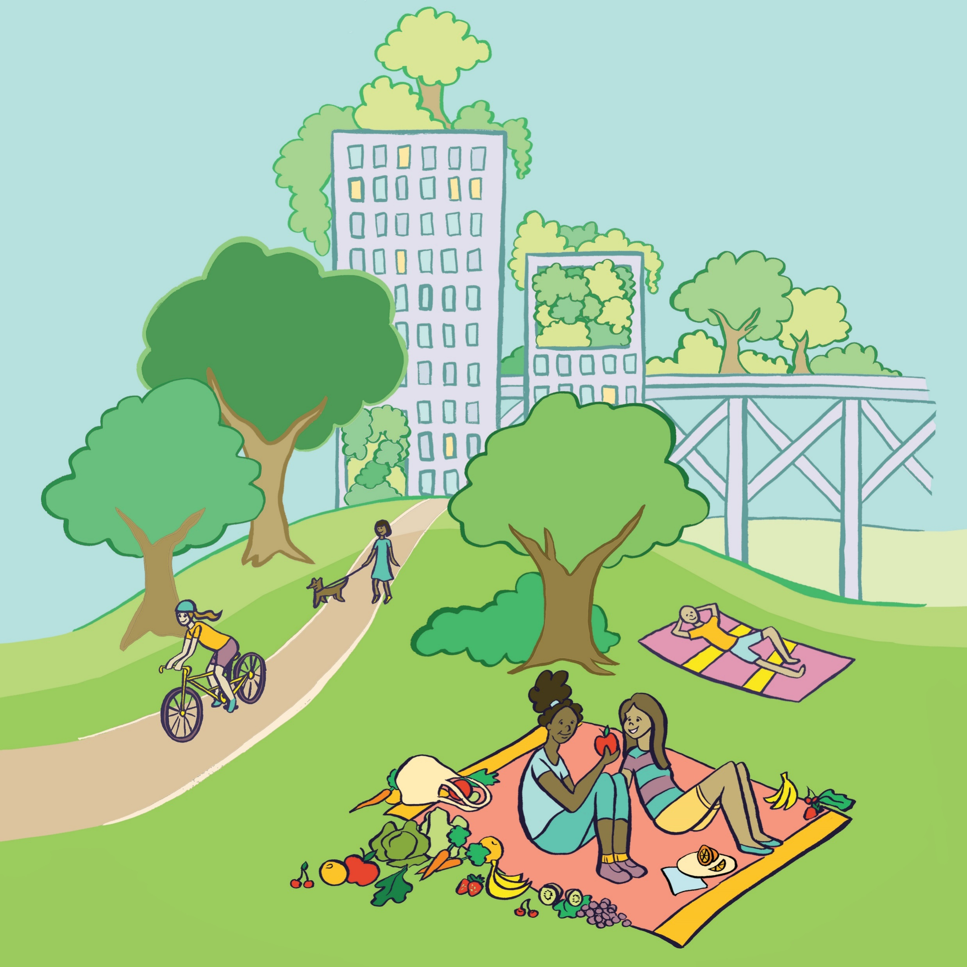
Action Plan
Develop new high-throughput tools to evaluate plant products for their potential in promoting human health, nutrition, and well-being. Those tools will apply to strategic screens of plants and associated biota to identify opportunities for future investment.
Develop a comprehensive understanding of the genetic, evolutionary, and environmental components of how plant systems–derived molecules confer beneficial or disadvantageous traits. Partnerships with environmental economists should be formed to develop metrics for quantifying ecosystem services, recreational benefits, and other environmental benefits.
Engage pharmacologists, medicinal botanists, indigenous peoples, and nutrition and food scientists to understand human metabolic processes and identify targets of plant-based medical compounds. Identify achievable health improvements that could come from enhanced plant systems through modification and breeding.
Develop technologies to improve health and well-being and reduce environmental impacts in densely populated environments through enhanced urban forestry, reforestation and greening opportunities, bioremediation, urban farming, and environmental conservation.

Slide 15
Launch the Transparent Plant
Visualize and model plants and phytobiome interactions
Understand the rules of plant diversification
Make predictions
Notes:
Full title: Goal 4: Launch the Transparent Plant, an Interactive Tool to Discern Mechanisms
Goal 4: is to “Launch the transparent plant tool” – which will allow scientists to model
plant interactions within the phytobiome,
understand the rules of plant diversification, and
make predictions.
The Decadal Vision proposes goals that respond to and mitigate climate change, support the nutritional needs of a growing population, and develop new plant-based products for consumers.
We have used a very nice analogy for building plants like Legos – can provide slides with Legos if interested.

Slide 16
Launch the Transparent Plant
From molecule and organelle to organism and ecosystem
Building schematics and models to understand how plants work
Understanding biodiversity between and within species

Slide 17
Action Plan
Use community input to develop a menu of desired traits to be predicted by the Transparent Plant and prioritize species (informed by Goal 1) and genotypes for intensive experimentation.
Invest in the generation of extensive transcriptomic, proteomic, biochemical, cell biological, microbiome, and phenomic data sets from priority species strategically selected to span evolutionary and ecological diversity (including both C3 and C4 plants), gathered at multiple scales and from multiple genotypes under an agreed set of environmental conditions.
Expand and standardize genomics databases to identify DNA regulatory elements found in plant genomes and reference phenotyping databases for the priority species. These databases will include genomic variations, epigenomic marks and DNA modifications, gene expression patterns, small RNAs, developmental stages, environmental responses, and gene regulatory and metabolic networks.
Invest in experimentation, data curation, and integration to assign functions to as many protein-coding genes as possible, together with a pathway or condition of interest for all non-coding genes in prioritized species.
Support development of new tools for dissecting, modeling, and simulating plant processes, informed by the collected data, that will allow multiscale analysis and prediction of plant responses. Initially, individual processes would be modeled. Then, after experimental validation, individual models would be progressively connected to create higher order models.
Develop a virtual reality module and visualization tools to begin testing the Transparent Plant, focusing on key aspects and capabilities such as interactions, scalability, and predictive capacity.
Notes:
Please don’t display this slide as is but rather highlight specific areas that would be relevant to the audience.

Slide 18
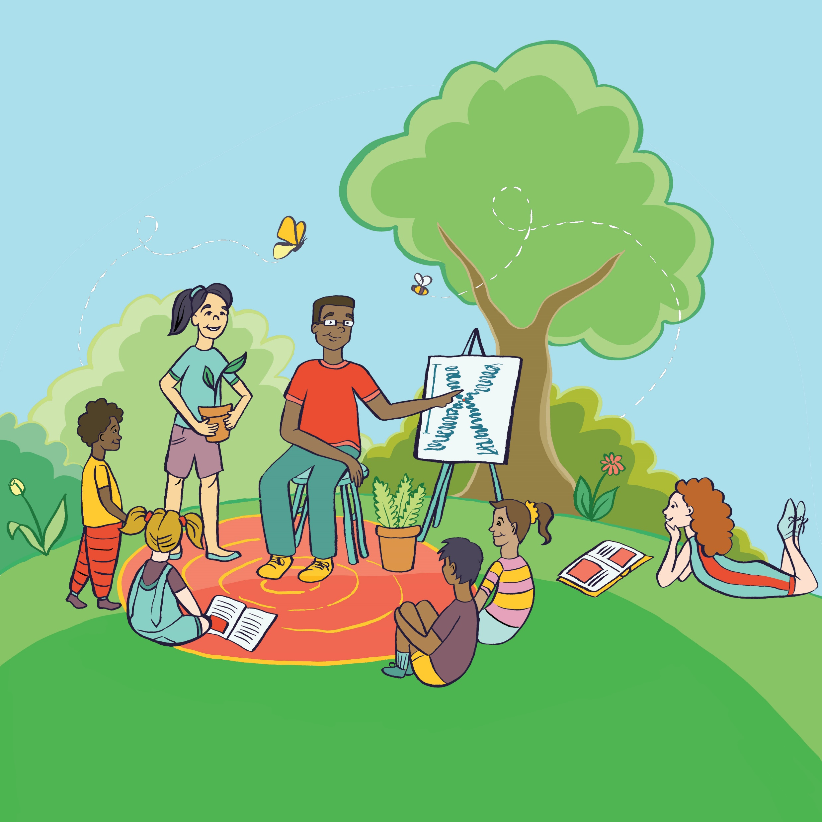
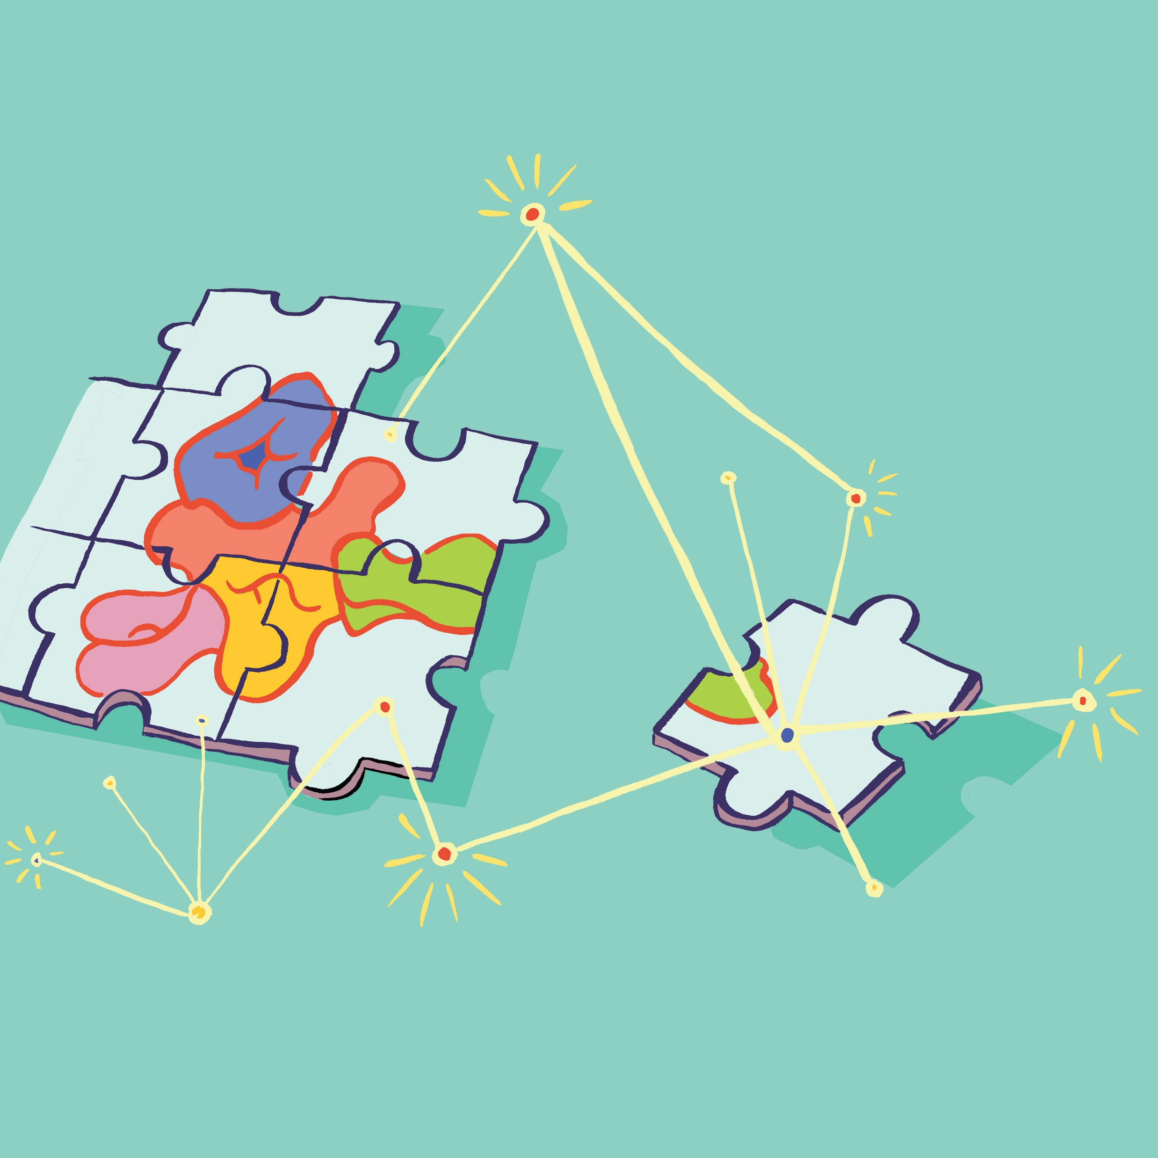
RESEARCH – PEOPLE – TECHNOLOGY
Kristyn Stickley Illustration 2020
Notes:
8 specific and interconnected goals that address Research, People, and Technology

Slide 19
Reimagine the Workplace to Nurture Adaptive and Diverse Scientists
How do we train scientists for diverse careers in agriculture, research, and related fields?
Notes:
Goal 5 describes recommendations to reimagine the workplace and inspire the next generation of scientists, with specific actions to support adaptive and diverse plant scientists.
Equity, diversity, and inclusion (EDI) are the cornerstones of greater participation and richer perspectives and are indispensable for fully realizing our vision for plant science.

Slide 20
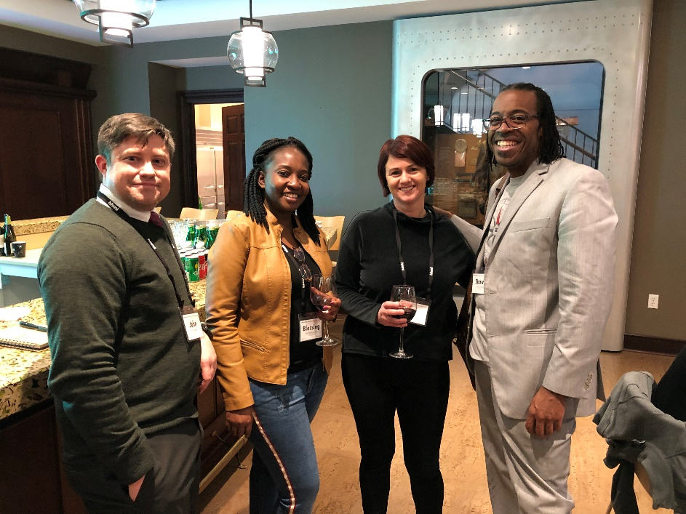
Reimagine the Workplace to Nurture Adaptive and Diverse Scientists
Nurturing equity, diversity, and inclusion
Recalibrating how research contributions are valued
Virtualizing the workplace
Scientists at the PSRN Inclusivity in the Plant Sciences Workshop
Notes:
Equity, diversity, and inclusion (EDI) are the cornerstones of greater participation and richer perspectives and are indispensable for fully realizing our vision for plant science.

Slide 21
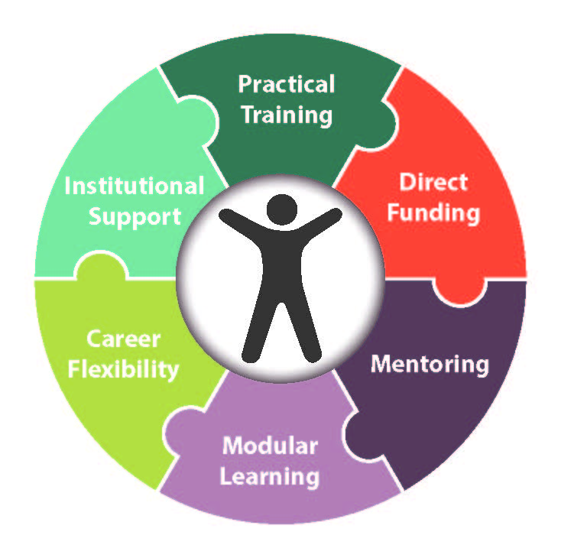
Reimagine the Workplace to Nurture Adaptive and Diverse Scientists
Direct funding and practical training for early career researchers
Institutional support and team mentoring
bit.ly/PSRNTraining
Notes:
The plant science institutions must ensure that the professional development needs of early career scientists are supported.
6 specific recommendations from our 2018 publication include support for mentoring, modular learning, and practical training.
This figure from our 2018 publication recommends putting the early career scientist at the center of their training and emphasizes individualized and customized professional development.

Slide 22
Action Plan
Incentivize academic institutions to rethink criteria for faculty hiring and promotion to place a premium on interdisciplinary collaboration, team science, and activities that support increased EDI.
Ensure that the outsized role carried by underrepresented faculty in supporting EDI is fully acknowledged and rewarded.
Fund postgraduates directly and provide multipoint mentoring coupled with the use of individualized development plans.
Provide customized T-training opportunities for diverse career pathways, incorporating microcredentialing for graduate and postdoctoral training that emphasizes integration across disciplines.
Support infrastructure and computational resources that underpin workplace virtualization and use this capacity to accelerate collaborative research and community science.

Slide 23
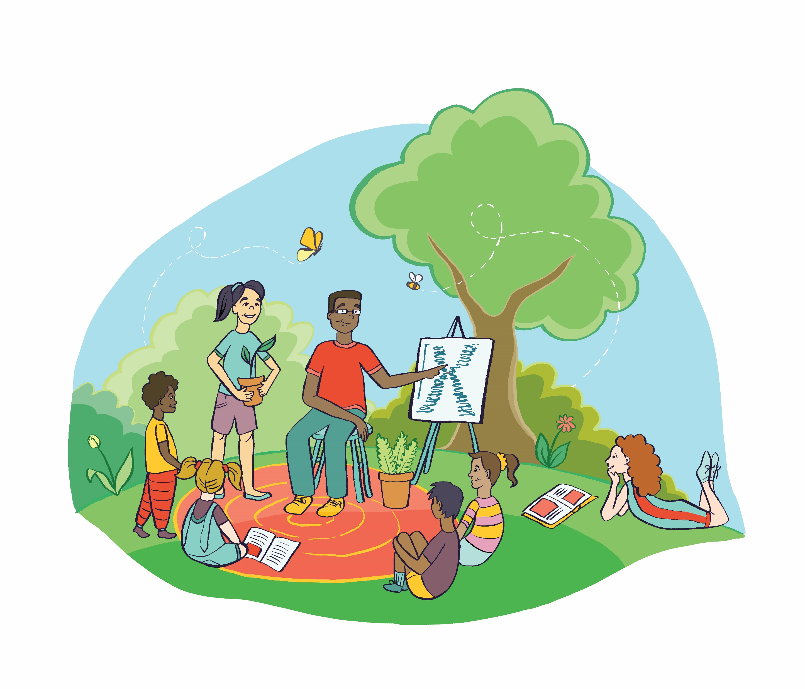
Build Capacity and Interest to Engage with Plant Science
Improve plant awareness through bold actions to expand plant science
Training in science communication
Early investment in plants through K12 and informal education
Develop a culture of active career planning for scientists at every level of training
Direct community engagement in science
Free-Choice Science Is an Ongoing Revolution
Notes:
Goal 6: "Build capacity and interest to engage with plant science."
One recommendation is to incorporate science communication into undergraduate and graduate training.
engaging the public through community science projects.

Slide 24
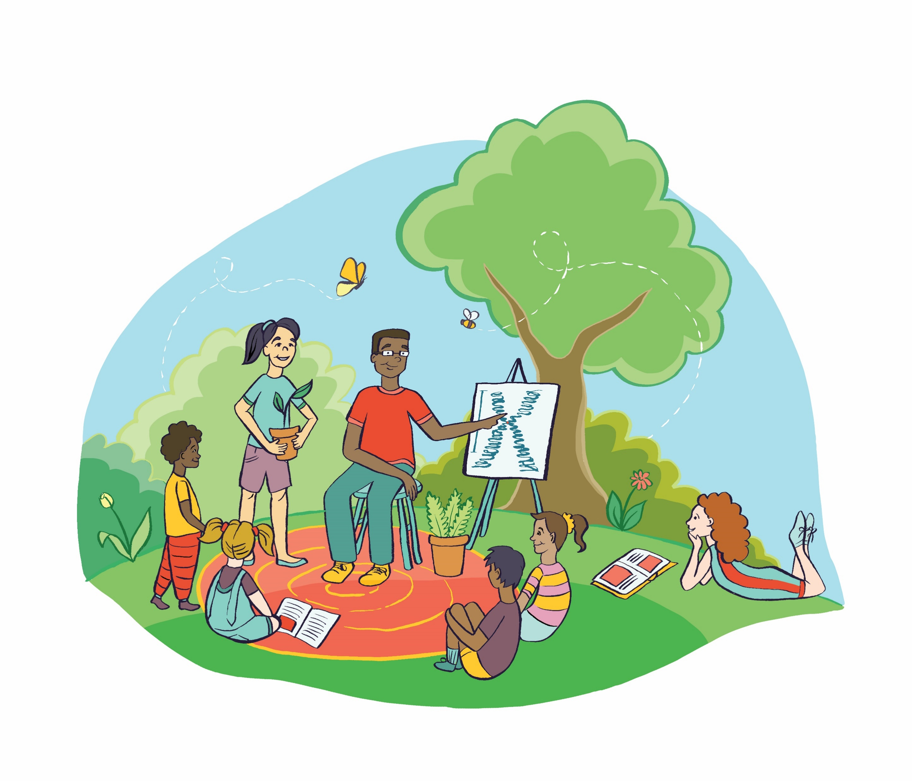
Action Plan
Improve and universalize science communication training for the current and next generation of plant systems scientists.
Integrate modern plant science education into standardized testing and curricula for secondary and undergraduate coursework and leverage networks of scientific societies to distribute lesson plans and amplify synergistic activities among organizations.
Develop resources and training modules to prepare the next generation of plant scientists for diverse career pathways.
Increase public engagement by plant scientists, especially through support of free-choice learning.

Slide 25
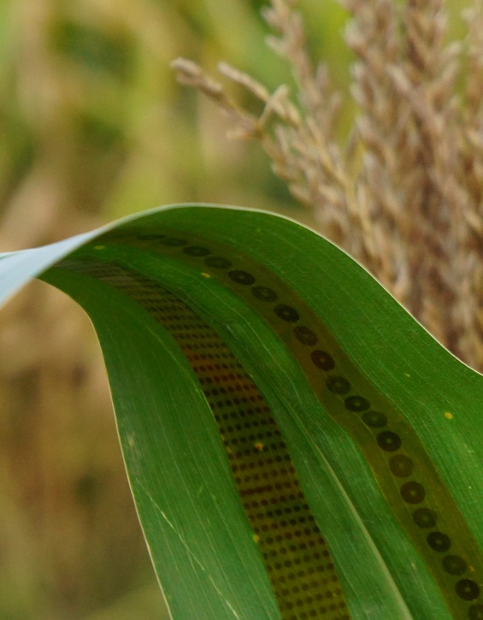
Develop New Technologies to Revolutionize Research
Plant Wearable Sensors. Source: Dr. Liang Dong (Iowa State University)
Notes:
We envision innovations in noninvasive imaging, sensors, machine learning, aerial vehicles, and other yet to be discovered tools to enable plant science research.
Improve noninvasive imaging
Apply sensors
Dealing with petabytes, zettabytes and beyond: culling, storing, interpreting

Slide 26
Develop New Technologies to Revolutionize Research
High-throughput technologies
Sensor technologies
Static and video imaging
Portable laboratories
Plant Wearable Sensors. Source: Dr. Liang Dong (Iowa State University)
Notes:
We envision innovations in noninvasive imaging, sensors, machine learning, aerial vehicles, and other yet to be discovered tools to enable plant science research.
Improve noninvasive imaging
Apply sensors
Dealing with petabytes, zettabytes and beyond: culling, storing, interpreting

Slide 27
Action Plan
Invest in high-throughput imaging technologies from the subcellular to the landscape level.
Improve sensor technologies to monitor in planta processes, metabolomics, and interactions with the environment.
Develop portable laboratory technologies using edge computing for real-time data capture and analysis in the field.

Slide 28
Manage and Realize the Potential of Big Data
Realizing each of the decadal vision goals will require technology for data collection (hardware) and analysis (software) on scales that dwarf what we can currently achieve.
Improvements in cyberinfrastructure including:
Data communication for field applications such as on-site multiaccess edge computing (mec) system to extract important features and signals
Machine learning and artificial intelligence
Information technologies

Slide 29
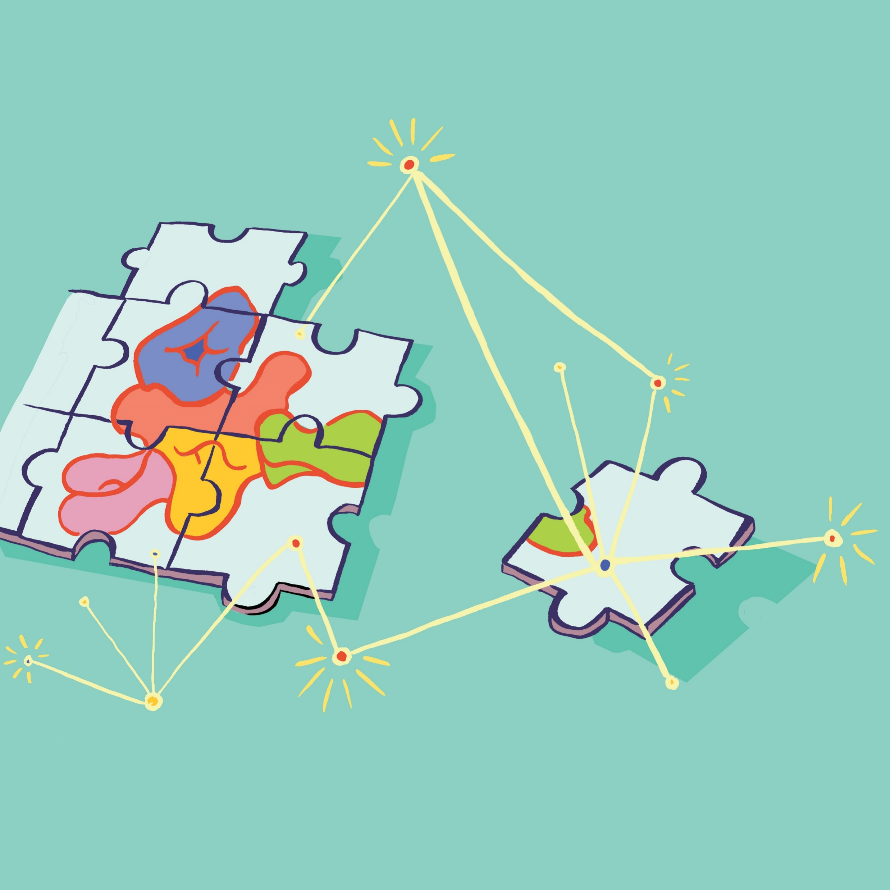
Action Plan
Establish and expand resources that enable integration of multimodal data including ontologies, data standards, and reference data sets.
Expand repositories of broadly validated and well-documented tools, models, and services for analyzing multimodal data including, but not limited to, ML models and AI software.
Strengthen the interoperability and federation of major existing repositories and analysis centers for multimodal data about plant systems, including expansion of web services and semantic tools.
Improve algorithms and hardware to support on-site processing for multimodal data streams and analytical intelligence in the field, including advanced MEC systems.
Complete the implementation of high-speed (currently 5G) Internet connectivity for all rural communities so that data analysis centers, research scientists, extension personnel, farmers, and ecosystems managers can all be integrated into the plant systems knowledge network.

Slide 30
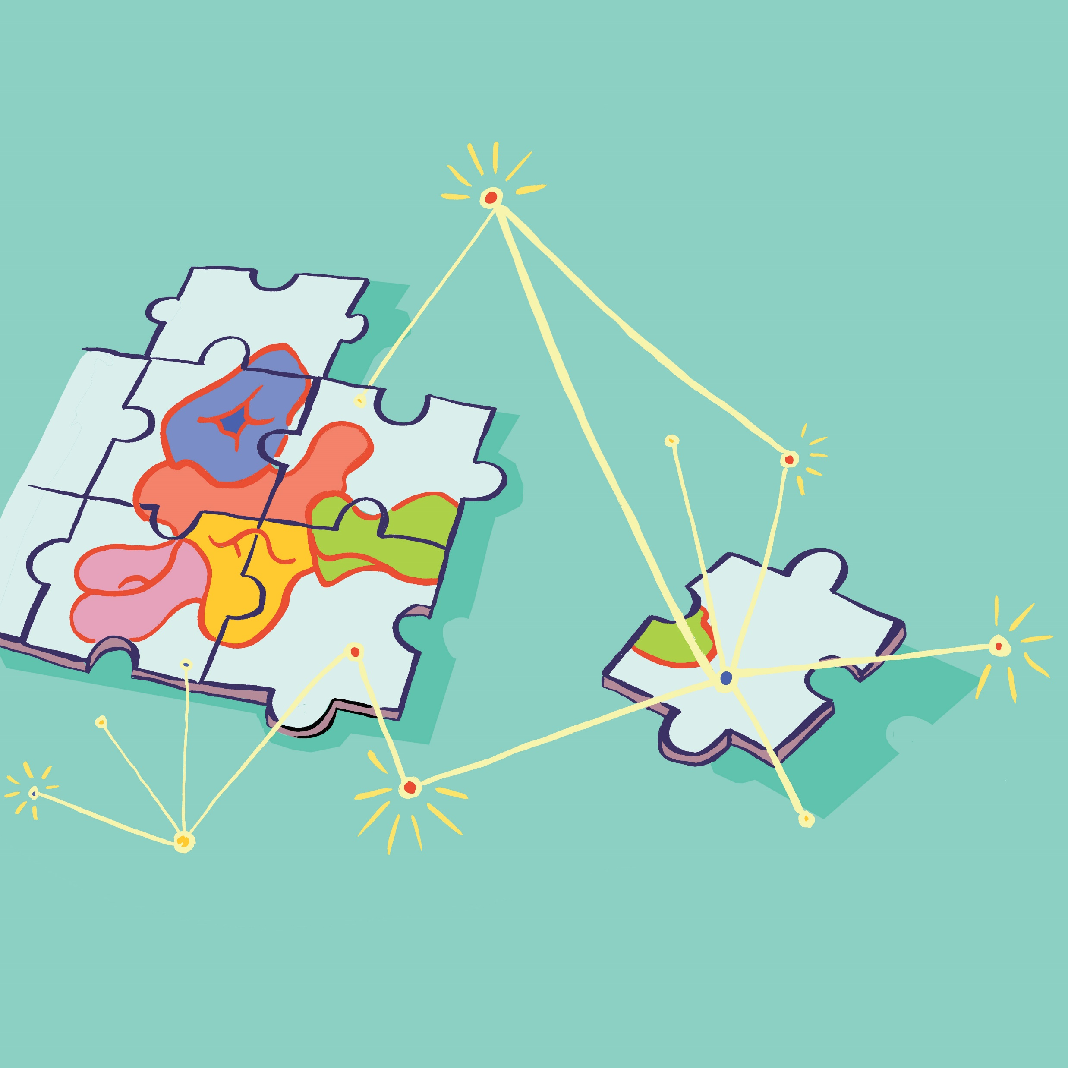
Impacts of the Decadal Vision
Respond to climate change
Feeding a growing population
Trends in plant-based foods and medicines
Illustrations by Kristyn Stickley, Kristyn Stickley Illustration 2020
Notes:
Impacts
The Decadal Vision proposes goals that respond to and mitigate climate change, support the nutritional needs of a growing population, and develop new plant-based products for consumers.
The potential impacts of this decadal vision will be to bring the plant science community together around a shared set of goals and aspirations for the future.
The Decadal Vision is also a critical tool for having conversations with policy makers to increase funding for plant science.
And may serve as a roadmap for congress, federal agencies, and early career scientists
Reinforcing the connections between plant scientists and support sustainable research
Increase funding for research – a roadmap for congress, federal agencies, and early career scientists

Slide 31
Impacts of the Decadal Vision
Connections between plant scientists
Increase funding for plant science research
Illustrations by Kristyn Stickley, Kristyn Stickley Illustration 2020
Notes:
Impacts
The Decadal Vision proposes goals that respond to and mitigate climate change, support the nutritional needs of a growing population, and develop new plant-based products for consumers.
The potential impacts of this decadal vision will be to bring the plant science community together around a shared set of goals and aspirations for the future.
The Decadal Vision is also a critical tool for having conversations with policy makers to increase funding for plant science.
And may serve as a roadmap for congress, federal agencies, and early career scientists
Reinforcing the connections between plant scientists and support sustainable research
Increase funding for research – a roadmap for congress, federal agencies, and early career scientists
Other applications:
Responding to climate change
Feeding a growing population
Trends in plant-based foods

Slide 32
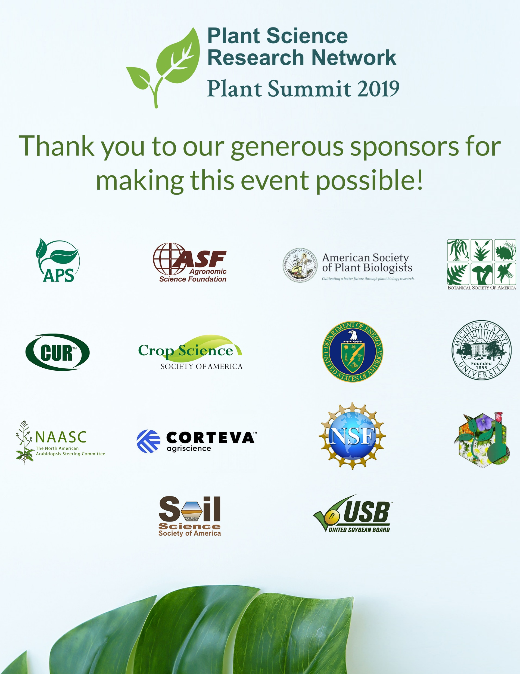
We invite you to read the Decadal Vision and access supporting materials online at plantae.org/PSRN Contact the PSRN coordinator: Natalie Henkhaus (nhenkhaus@aspb.org) Twitter: @PlantSciResNet
Plant Science Decadal Vision 2020–2030
Notes:
Please feel free to use a different image in the summary!
One of the first few slides might be a better fit – such as the image of Summit Attendees with the Plantae screenshot. Or the cover of the DV.
I would like to thank you for participating in this presentation and the groups supporting this work.
Please visit plantae.org/PSRN to connect with the members of the Plant Science Research Network, learn more about the decadal vision, and access Decadal Vision supporting materials.

